Slide 1
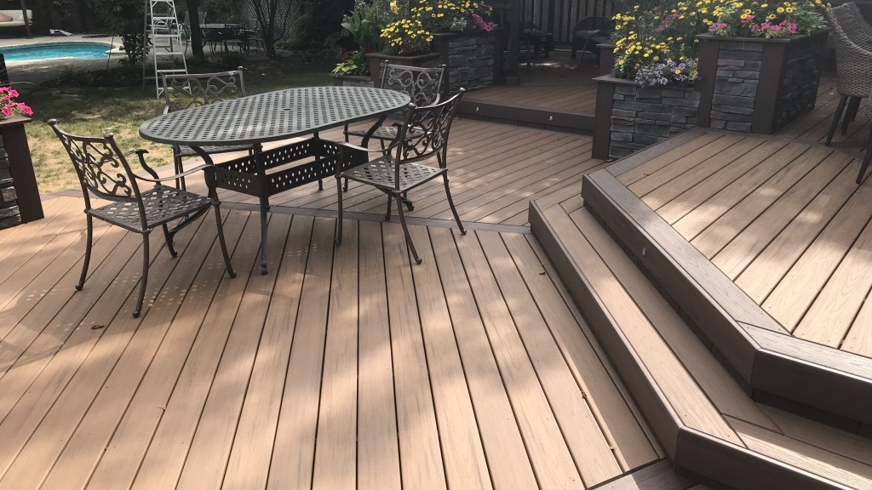


The Ultimate PVC Decking Solution
DURABLE
STYLISH
LOW-MAINTENANCE

Slide 2
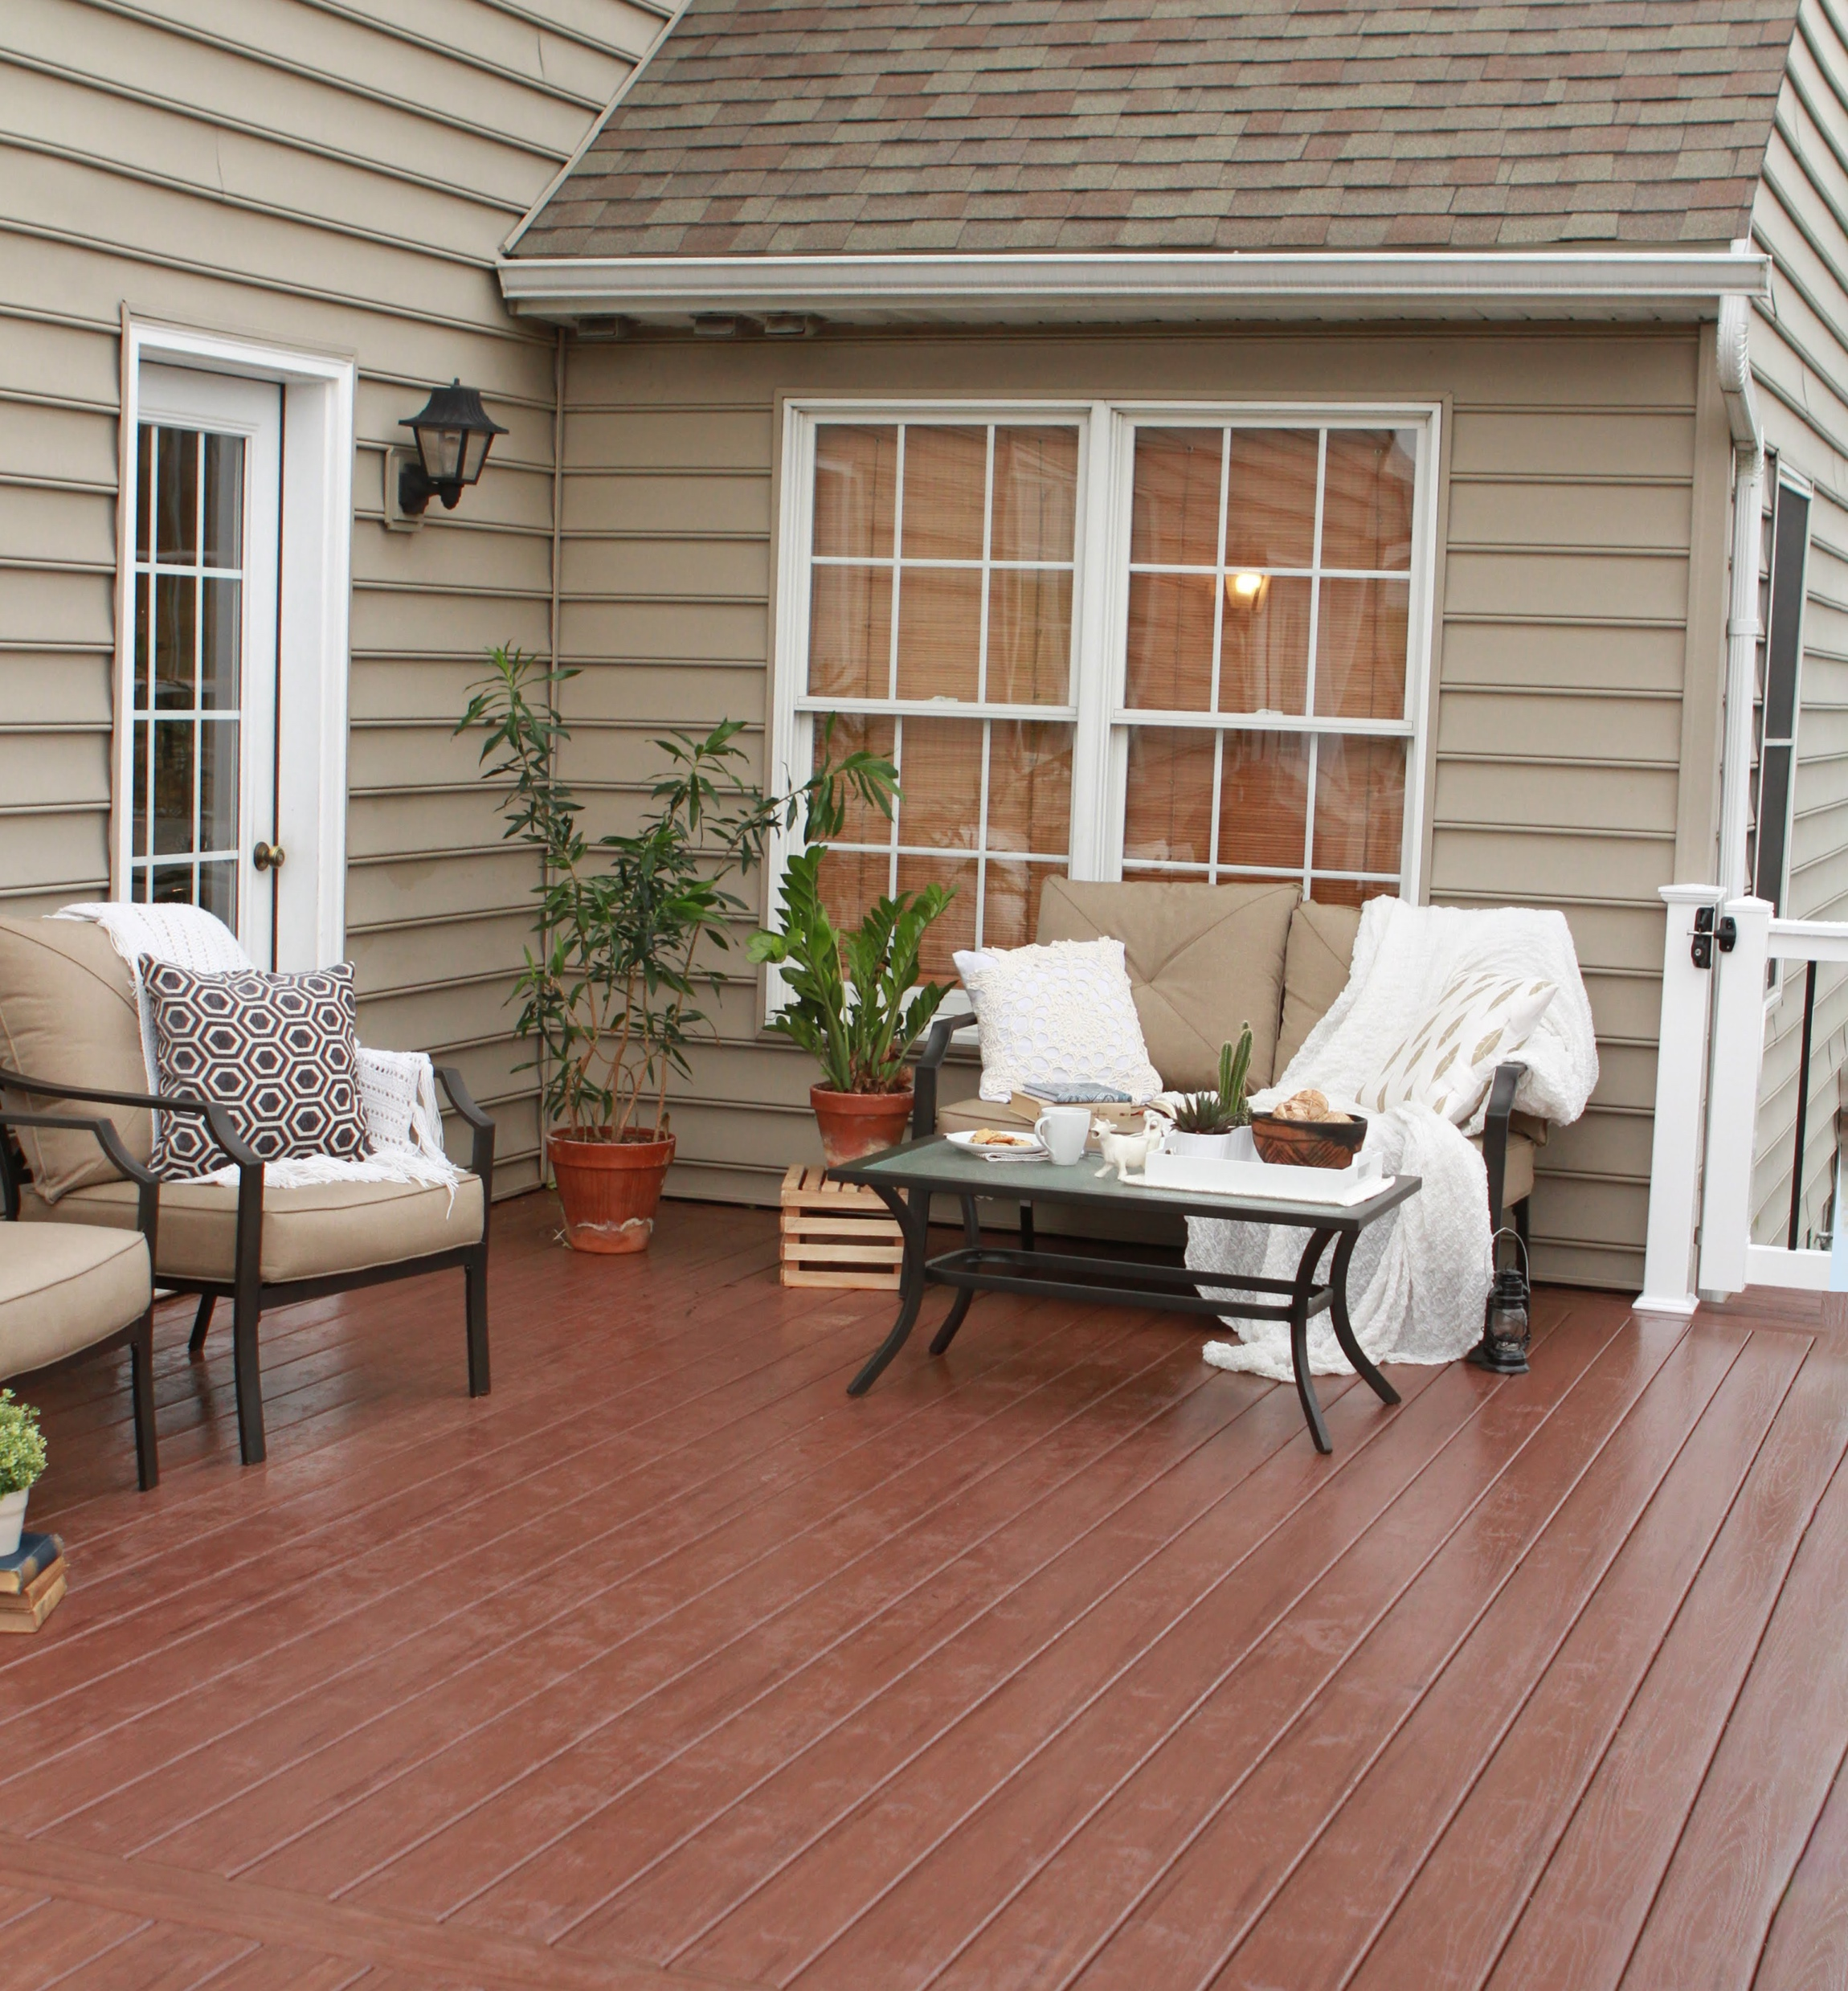

About VEKAdeck
Innovative, Eco-Friendly, Versatile
Precision-Crafted PVC Deck Profiles VEKAdeck is the premier choice for outdoor spaces, providing durability, realistic wood looks, low maintenance, and environmental sustainability.
Versatile Color Options
Durable & Long-lasting
Weather Resistant
Lighter than Wood or Composites
Superior Color Retention
100% Recyclable
Mold and Mildew-Resistant
Low Maintenance
Fire-Resistant
Slip Resistant

Slide 3
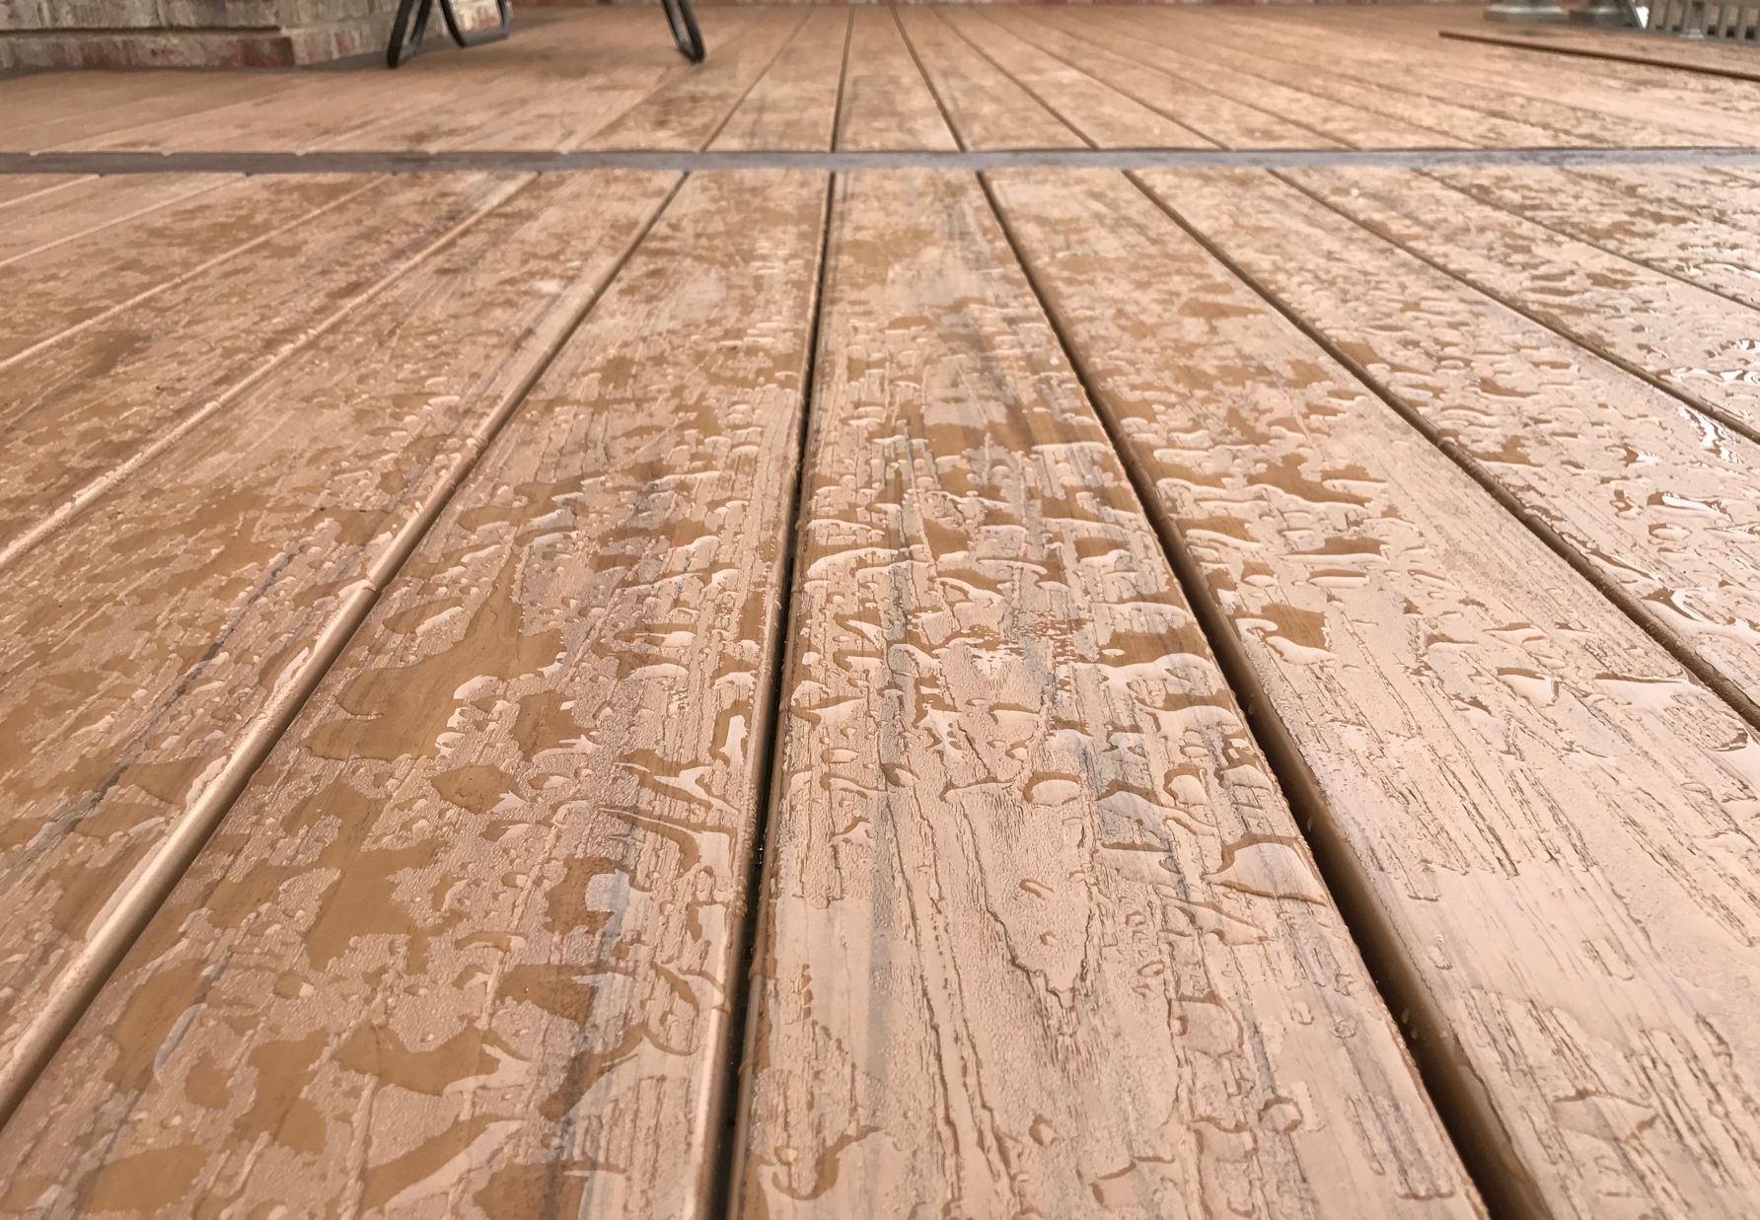
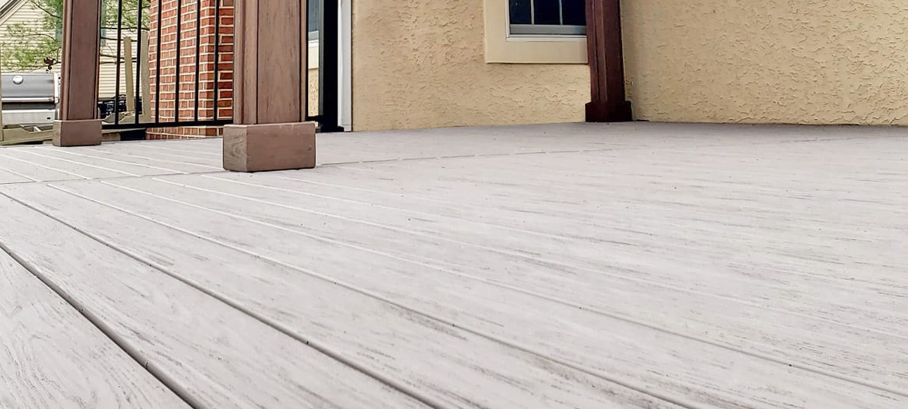
Longevity and Wear Resistance
VEKAdeck is formulated to minimize maintenance and prevent common problems associated with wood, such as mold and insect infestations.
VEKAdeck is 100% recyclable.
VEKAdeck has no organic content, meaning that mold and mildew have nowhere to go.
PVC is a lighter weight material, easier to transport and work with.
PVC vs Composite
PVC DECKING | COMPOSITE DECKING
Fully synthetic | Semi-synthetic
Most realistic woodgrain character | Wood-inspired looks
Most durable: resistant to rot, mold, and insects | More durable than wood
Limited lifetime warranty | 25-30-year warranty

Slide 4
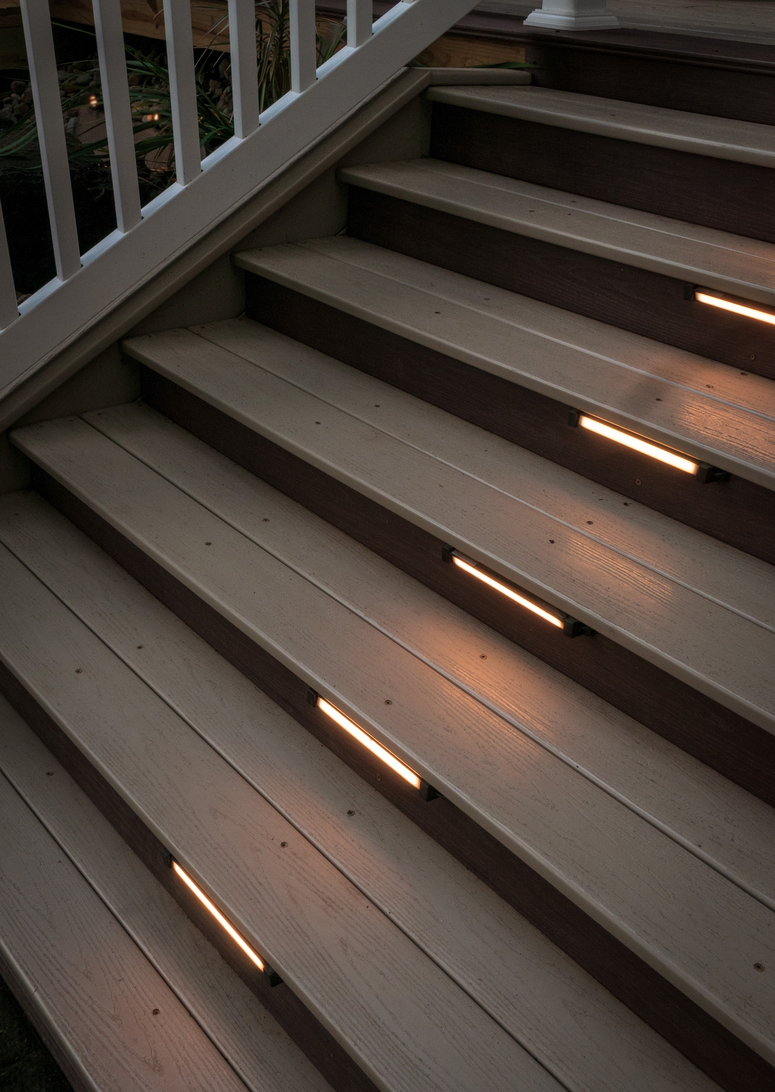









Key Features
Style Meets Strength
Versatile Color Options
Durable and Long-lasting
Weather Resistant
Mold and Mildew Resistant
Slip Resistant
Embossed Woodgrain Surface
Lighter Weight
Low Maintenance
Fire Resistant

Slide 5
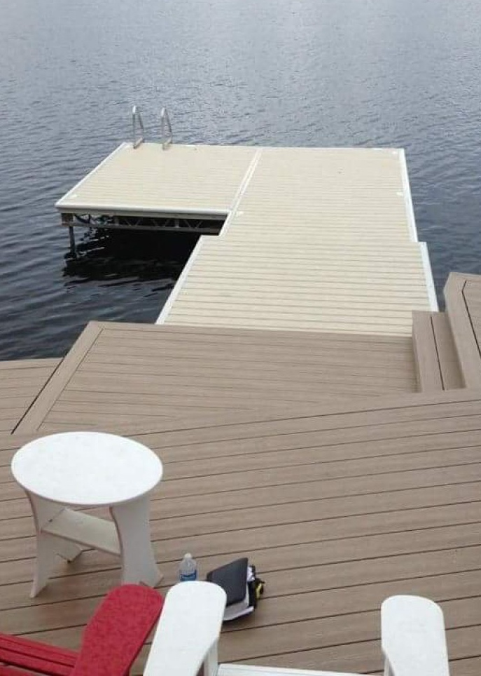
Additional Features
Proven Quality
Embossed attractive woodgrain on the surface, for exceptional traction even in wet or slippery conditions.
Thermally reflective to help keep you cooler underfoot.
Unique formulation of 100% PVC, performance modifiers and color pigments has low expansion and contraction.
Moisture-resistant and impervious to salt, VEKAdeck is a top choice for deck builders across America.

Slide 6
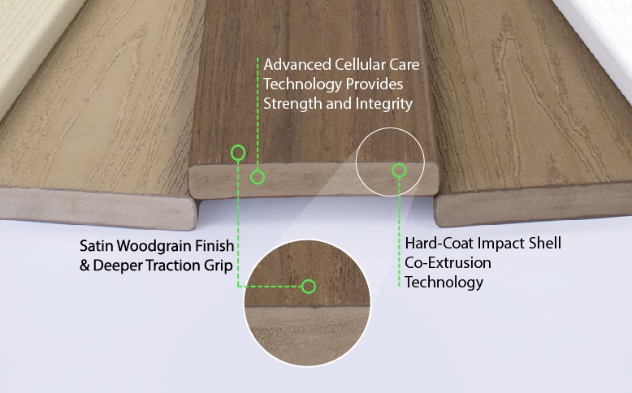
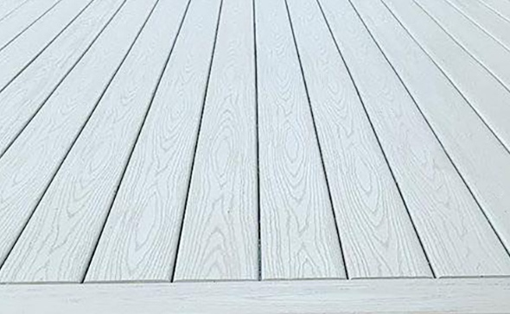
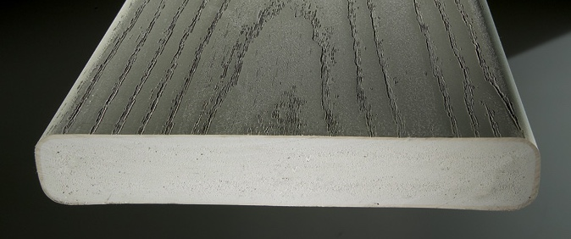

Tested & Certified
VEKAdeck has been evaluated by Intertek Code Compliance Research Reports (CCRR-0137), the leading source of technical information on building codes, products, and technology and complies with the latest IBC and IRC Building Code standards.
Not a Composite -100% Cellular PVC Core
“ The Ultimate Guide to Make a Career in Interior Designing
In simplistic terms. “

Slide 7
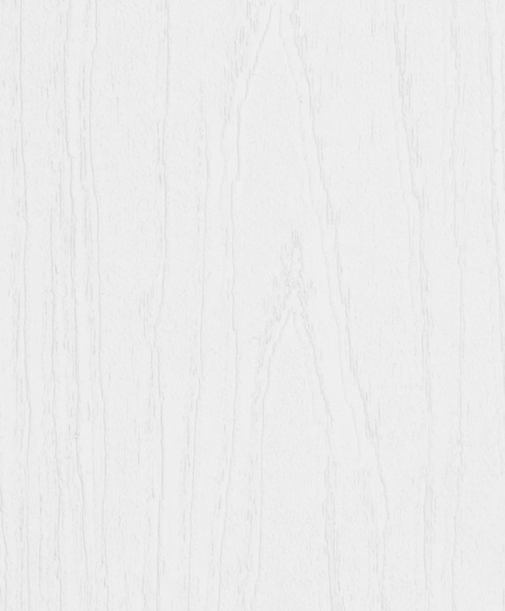
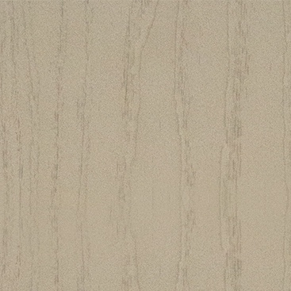
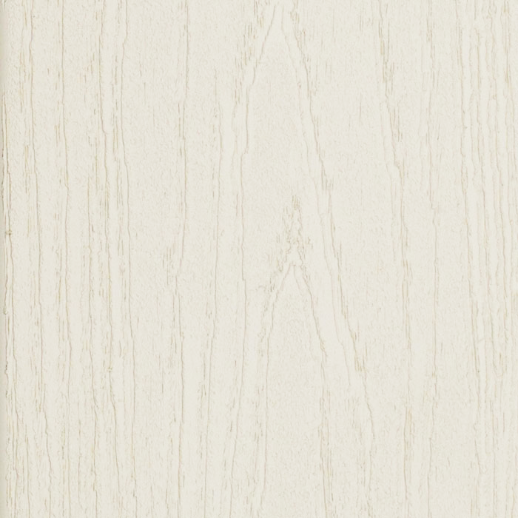
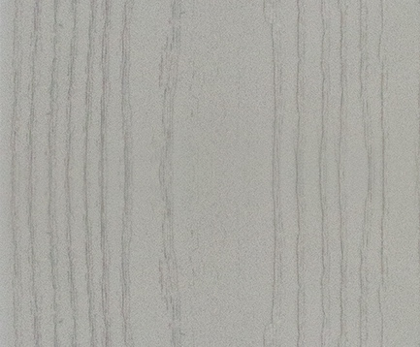
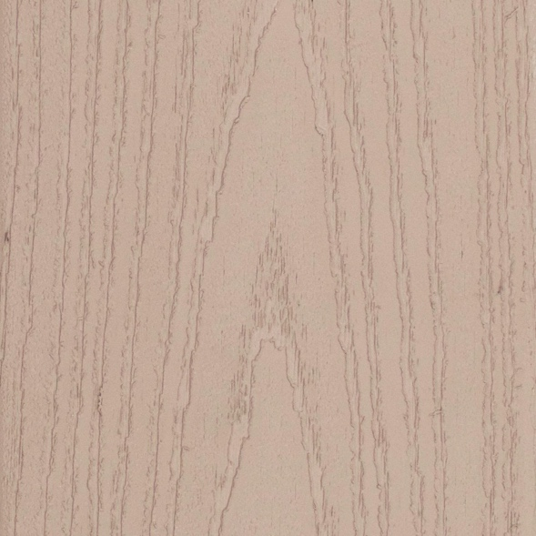
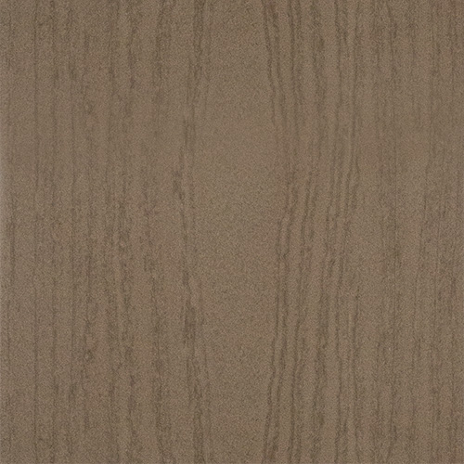
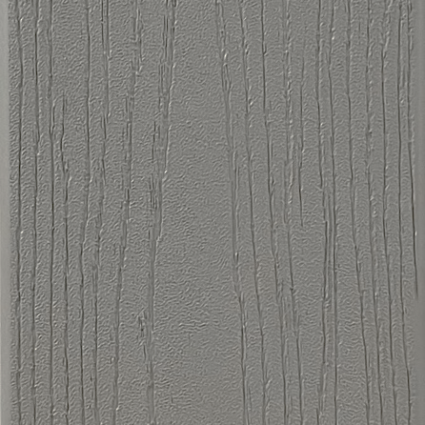
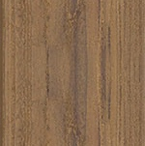
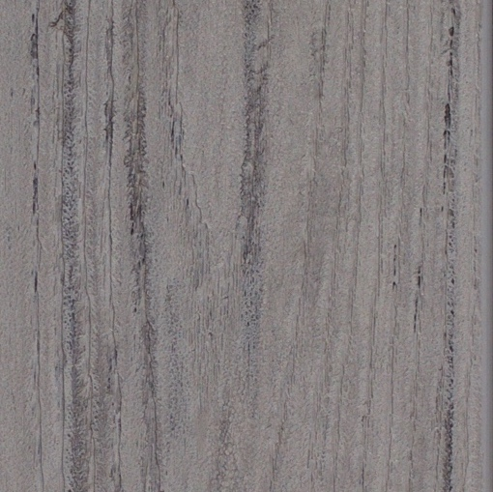
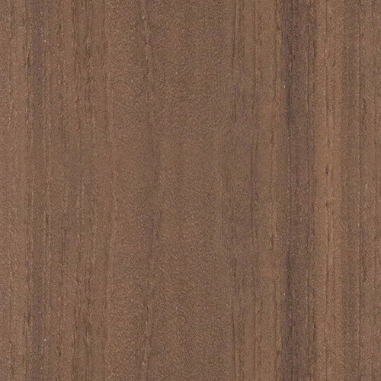
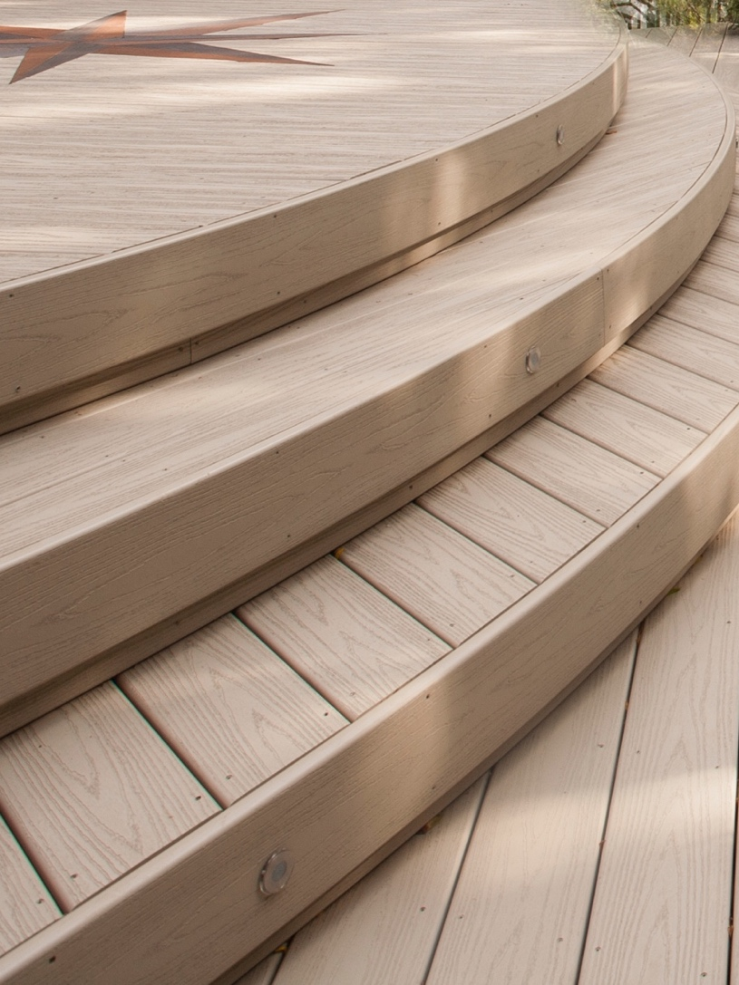
VEKAdeck & Fascia Color Options
Impact-resistant VEKAdeck fascia colors perfectly match VEKAdeck colors
WHITE
KHAKI
ALMOND
GREY
MOCHA
WALNUT
SIGNATURE
SIGNATURE
SIGNATURE
SIGNATURE
PEWTER
HAZELNUT
ESPRESSO
STORM
CAYENNE
For custom looks, install VEKAdeck
fascia boards on curves and semicircles.

Slide 8
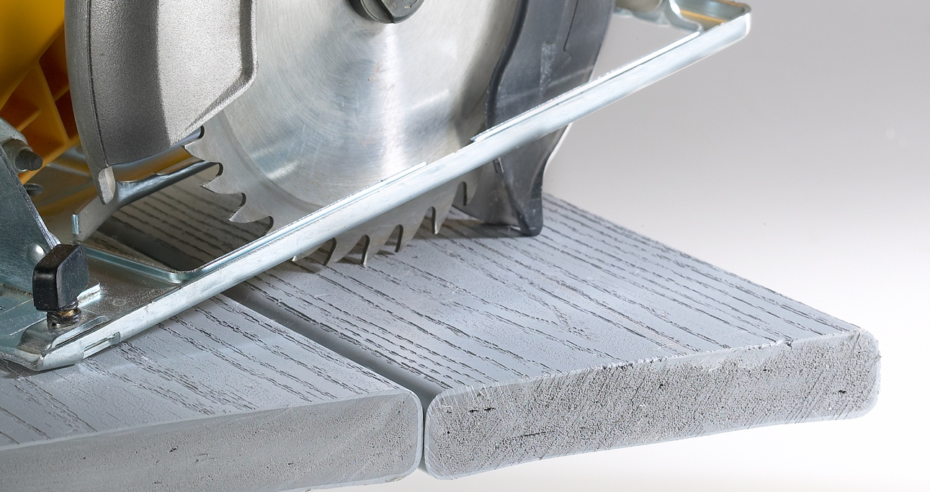
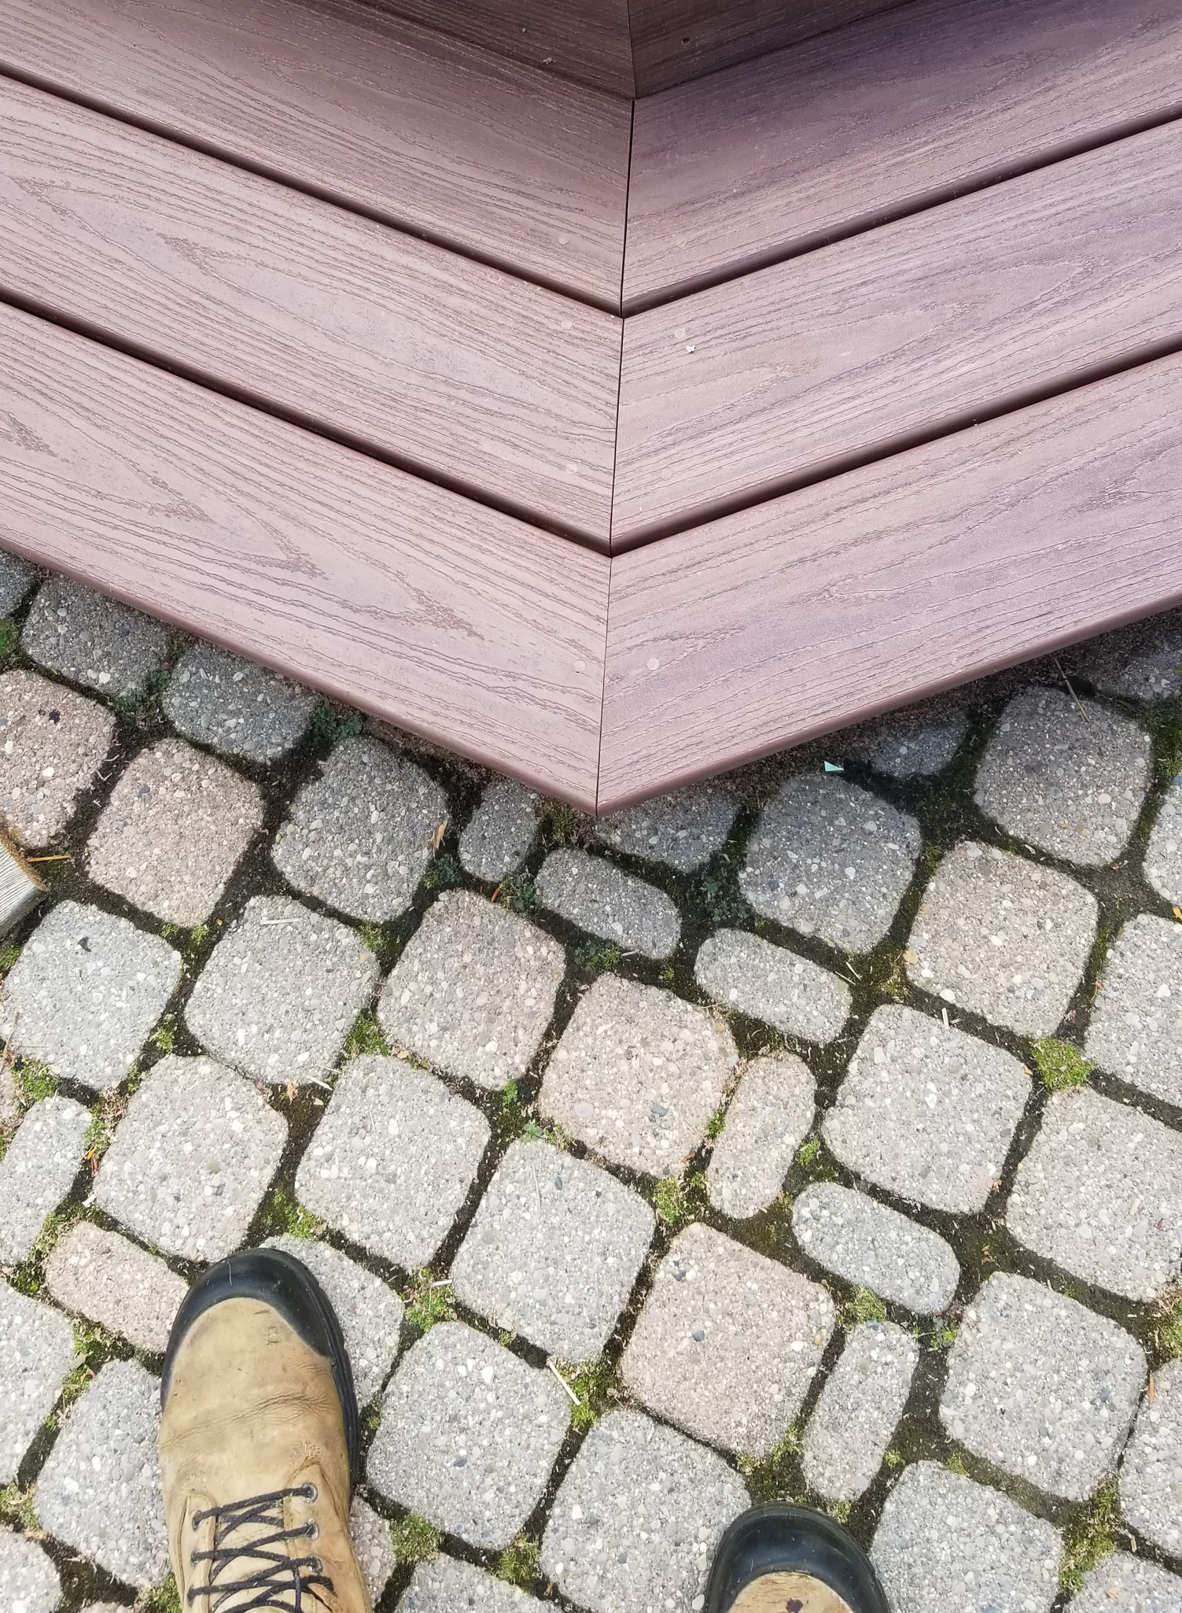
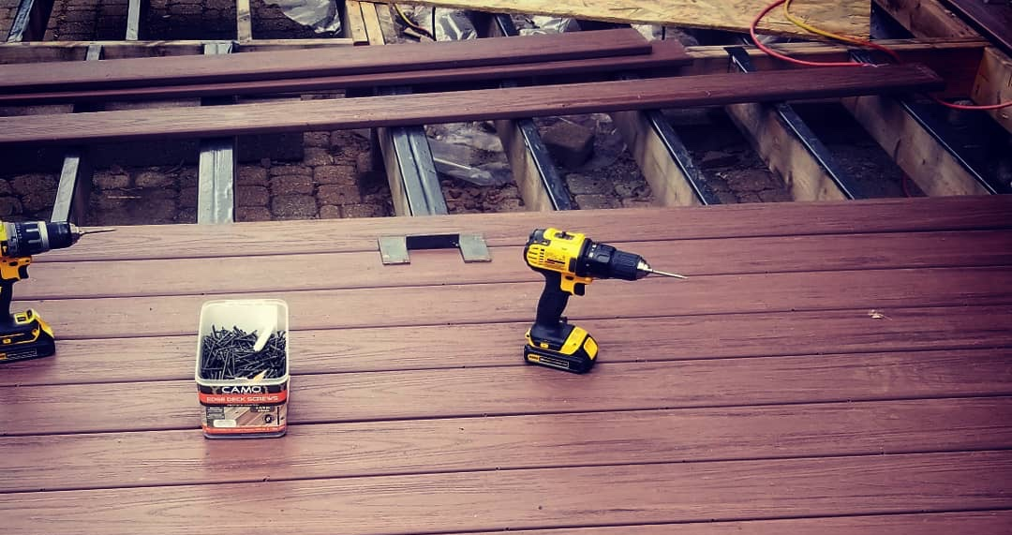
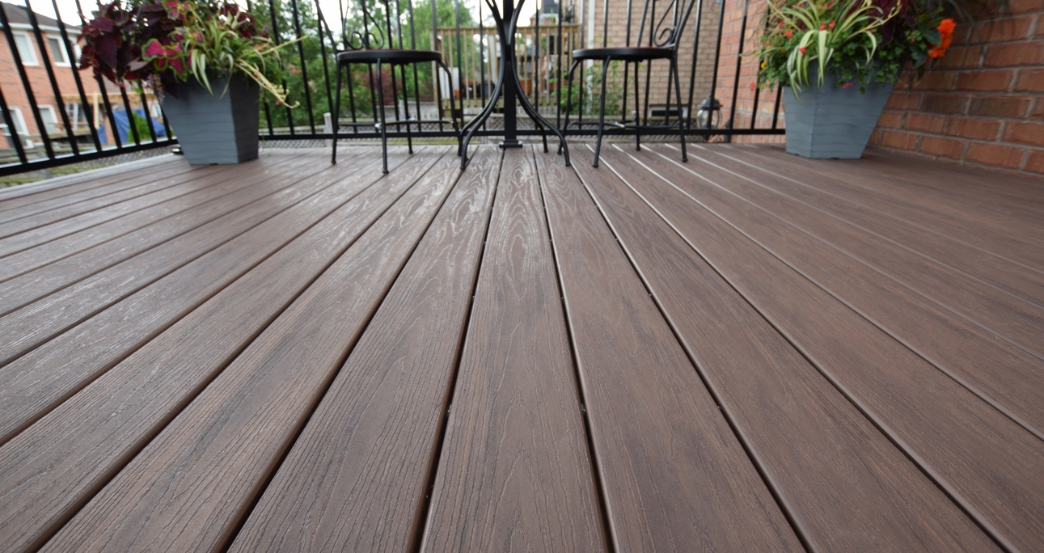
Installation
& Maintenance
Effortlessly installed with traditional tools, VEKAdeck material is easy to work with and cut.
VEKAdeck can be sawed at any angle and is self-countersinking; the board will not mushroom, and resists splits better than most woods and composites.
VEKAdeck easily accepts screws, and most types of fasteners. VEKA recommends stainless steel screws for best performance.
Routinely clean your PVC decking with a mild soap and water solution to prevent dirt buildup.
Avoid using abrasive cleaning tools to prevent scratching the surface of the PVC decking.
Power washing is an acceptable method for cleaning VEKAdeck; set pressure washer to manufacturer’s recommended setting for vinyl to avoid damage.
INTERIX
Office Interior Design
They take into account all furnishings that necessarily have to be present.

Slide 9
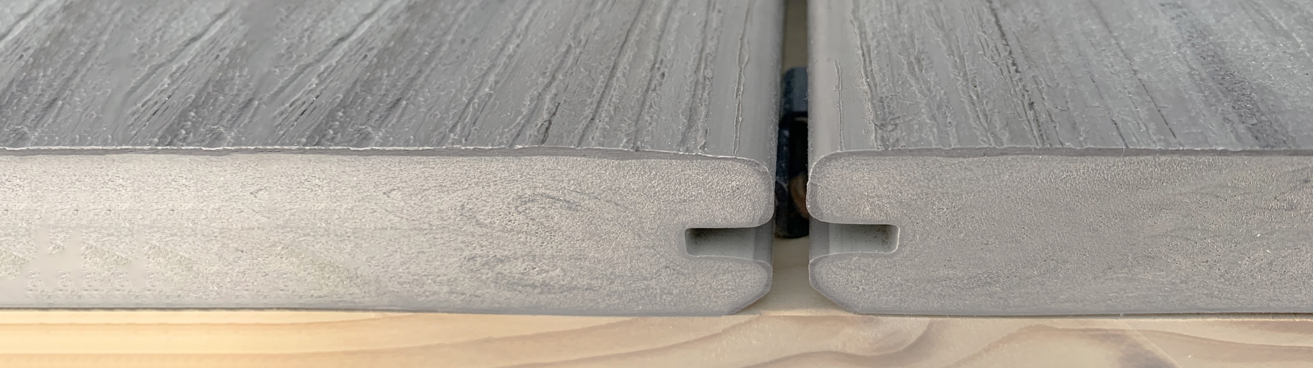
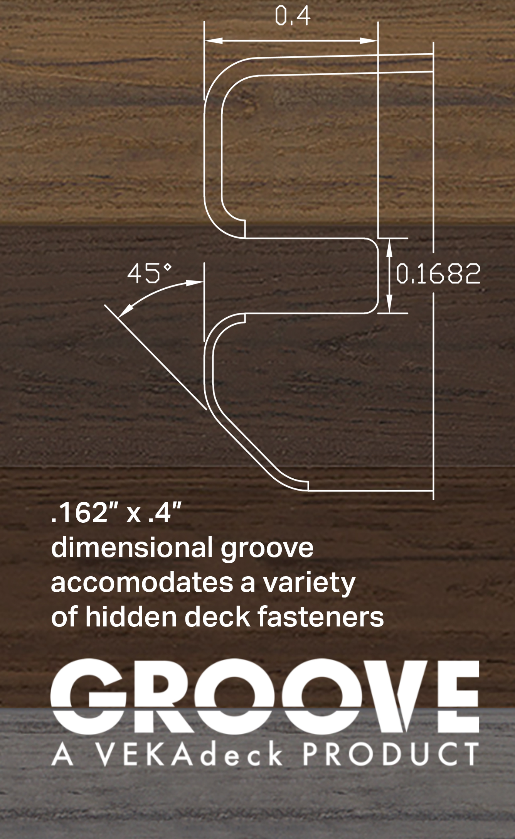

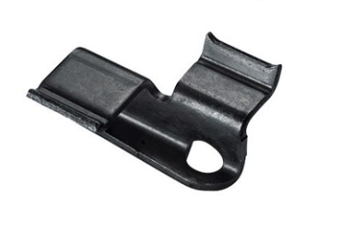
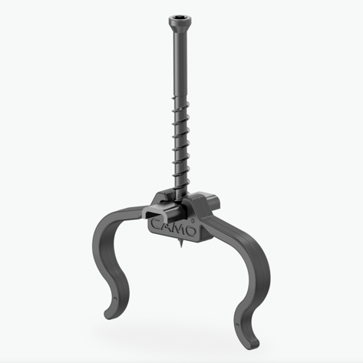
Proven quality with a modern, clean look
A beautiful deck surface without
visible screws
Compatible with most hidden deck fasteners designed for slotted PVC deck boards
The upper surface remains uncompromised by screws, plugs, or other systems that could affect its dimensional integrity

Slide 10

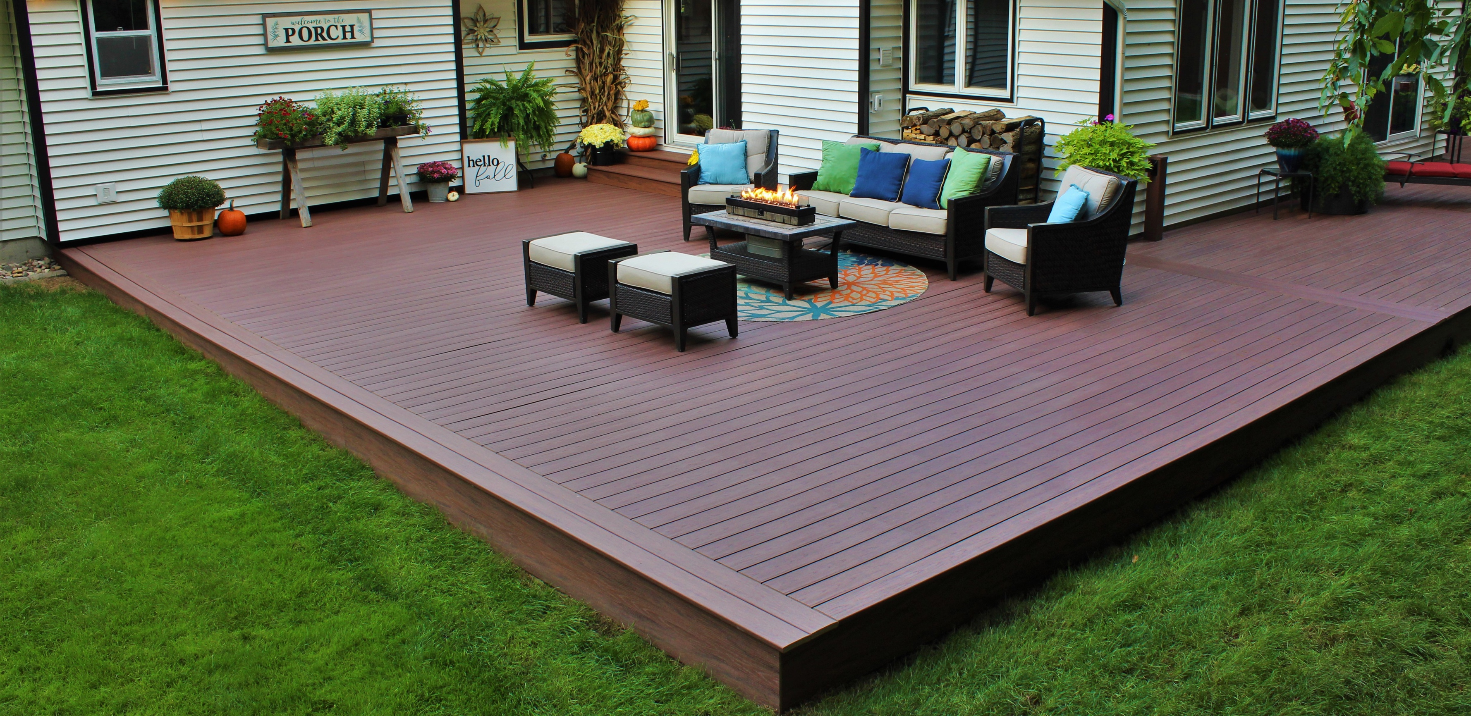
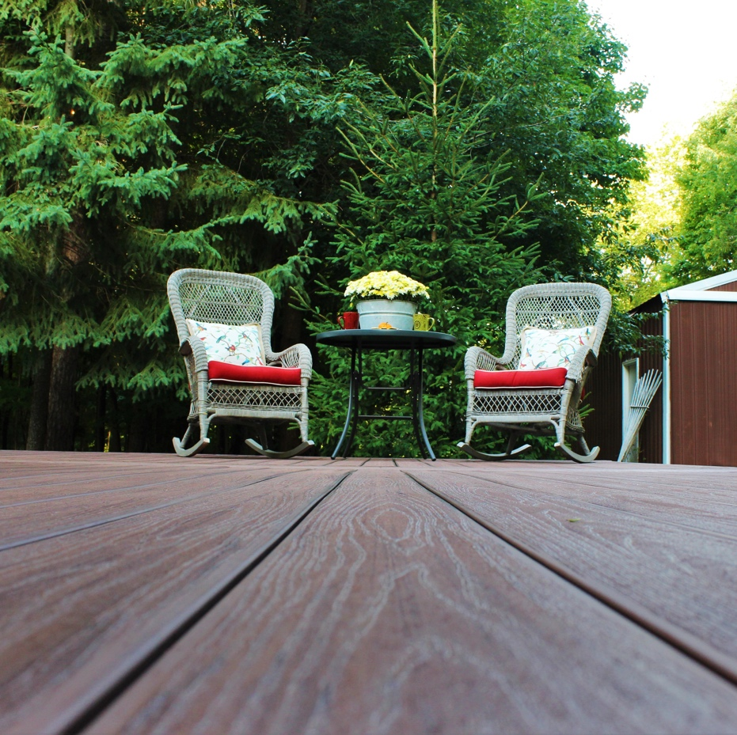
SIGNATURE
CAYENNE
VEKAdeck GROOVE is available
in our Signature VEKAdeck colors
SIGNATURE
STORM
SIGNATURE
ESPRESSO
SIGNATURE
HAZELNUT

Slide 11
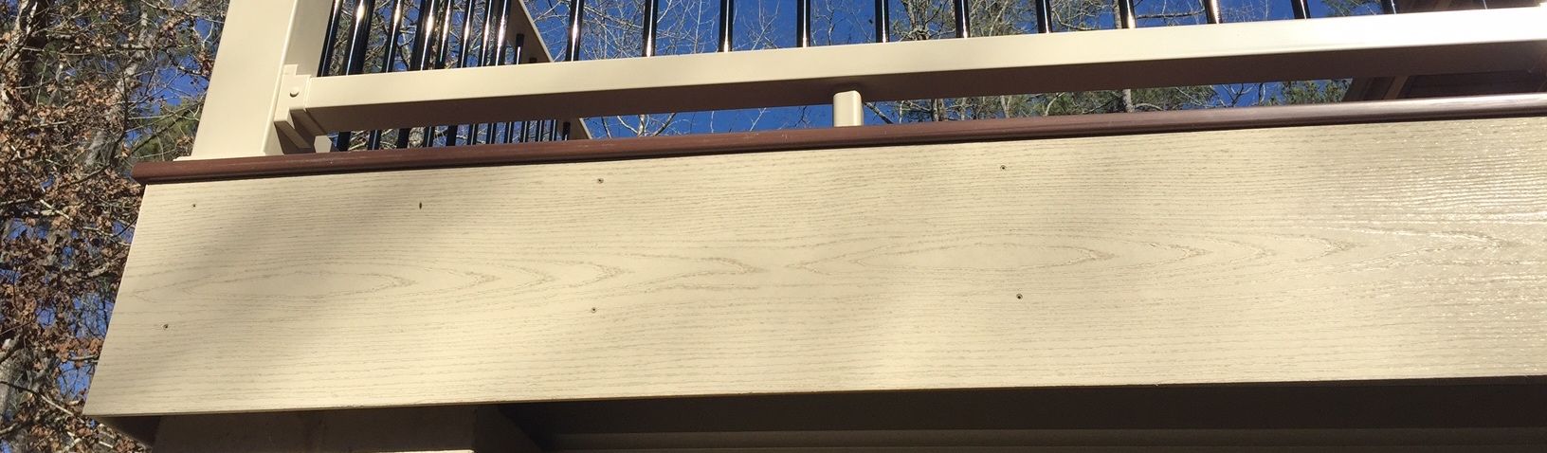
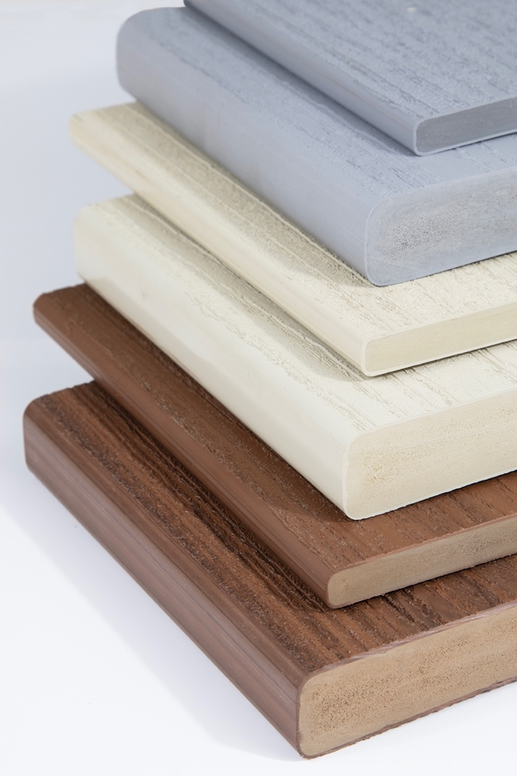
VEKAdeck
Fascia Board
A perfect combination of durability
Uses the same proven formula as VEKAdeck
Available in 12" widths
7/16" Thickness (.0437 in.) solid board
Installs just like VEKAdeck, can be nailed with stainless steel trim nails,
or screwed with trim-matched screws
Easy to cut, saw and trim
Low maintenance, never needs painting or staining, cleans easily saving you time and money
Limited Lifetime Warranty
Seamless blend in design
Coming soon! 8" Riser Board

Slide 12
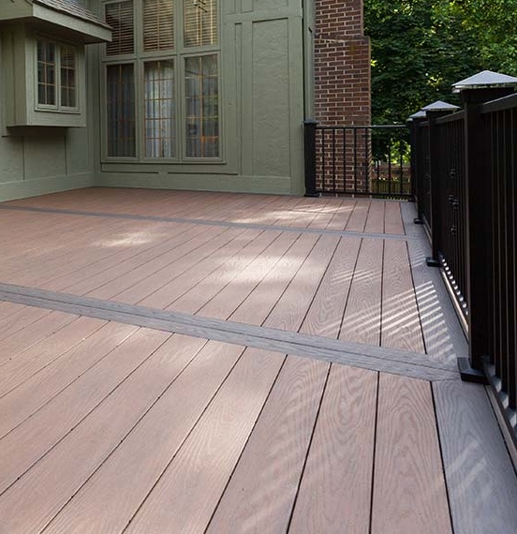
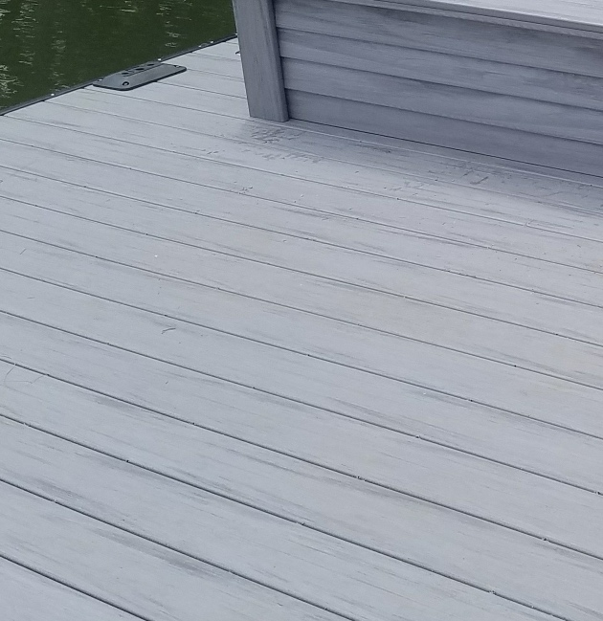
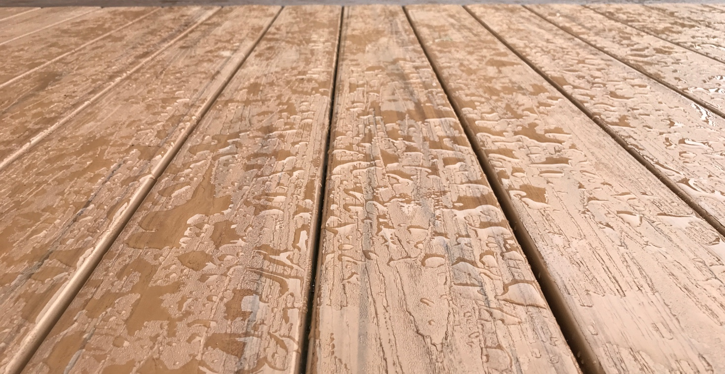
A Proven Formula
Hardness and Surface Durability
VEKAdeck’s unique cellular PVC formulation assures a long-lasting beautiful performance.
Because of its superior surface strength, VEKAdeck’s beautiful woodgrain pattern
withstands years of traffic, throughout the life of the product.
VEKADECK | 75
OAK | 70
COMPOSITES | 65
PINE | 50
Office Interior Design
They take into account all furnishings that necessarily have to be present.

Slide 13
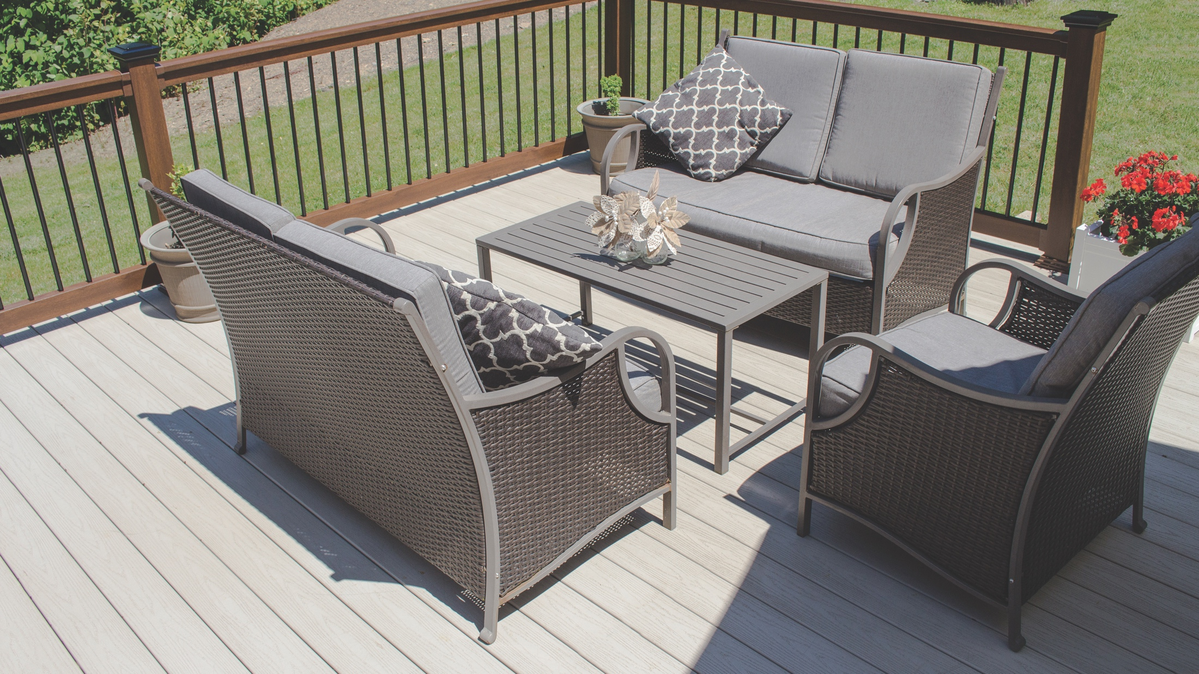
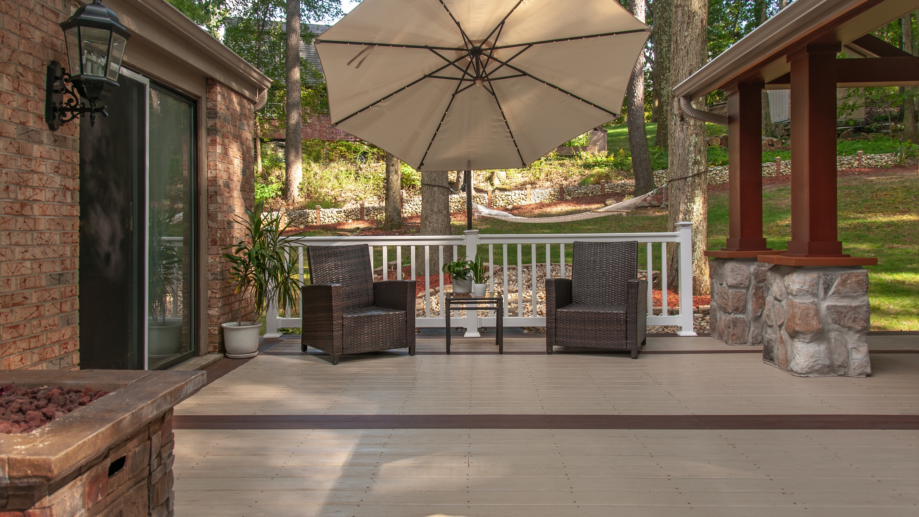

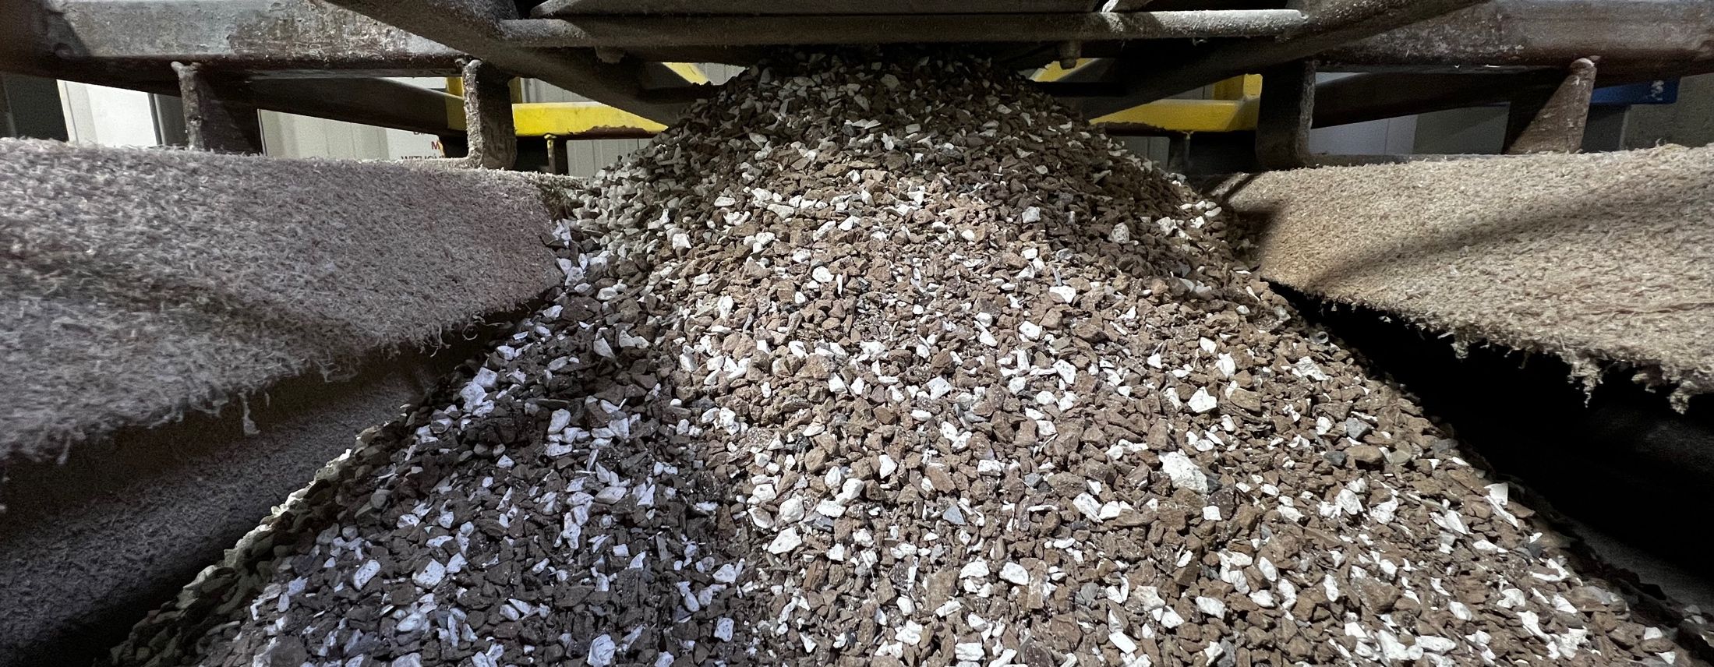
“ The Ultimate Guide to Make a Career in Interior Designing
In simplistic terms. “
Eco-Friendly Recyclable PVC
Designed with Sustainability in Mind
As a recyclable material, PVC saves our precious forest resources from being depleted. Over the last 20 years, VEKA North America has used pre-consumer, mixed-color reclaimed PVC for handrail, as well as packaging containers.

Slide 14
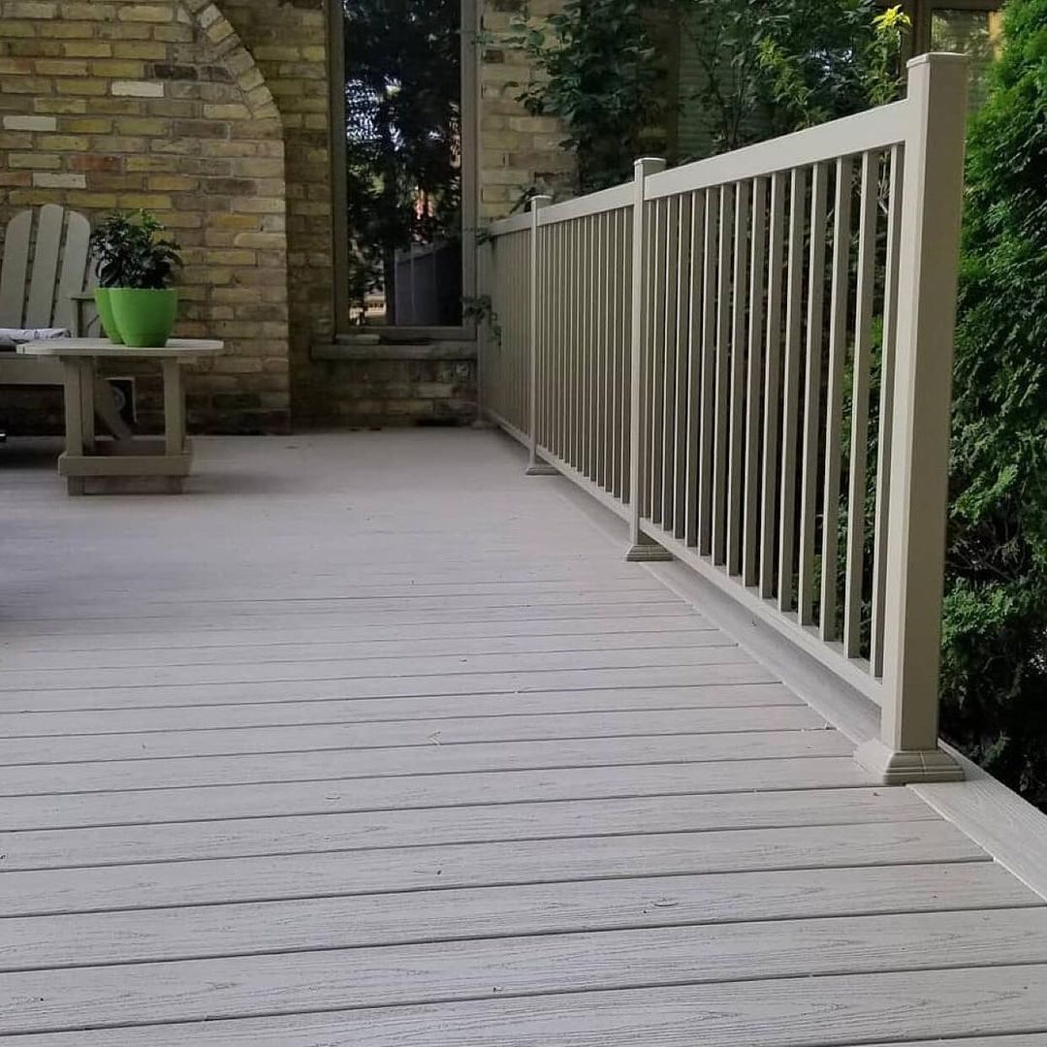

Rubber-Backed Mats
Long-Term Value
The combination of sun, water, and the chemical properties in rubber-backed mats will adversely affect all PVC deck materials.
Hemp or colorfast woven rugs
are recommended.
Care and
Maintenance
Suntan/Sunscreen
Lotion or Sprays*
VEKAdeck’s superior capstock is stain-resistant, unlike most other deck boards
Unlike wood and wood composites, VEKAdeck will resist fading and retain color longer
These products contain chemical ingredients that may react with the decking material and result in a
stain on the decking surface.
Bug Spray*
These products contain chemical ingredients that may cause discoloration of the vinyl product surface.
*Apply these products indoors, off the deck, away from railing and fence, or in such a way that over-spraying of product will not come in contact with the deck surface. (Visit vekaolp.com for more info)

Slide 15
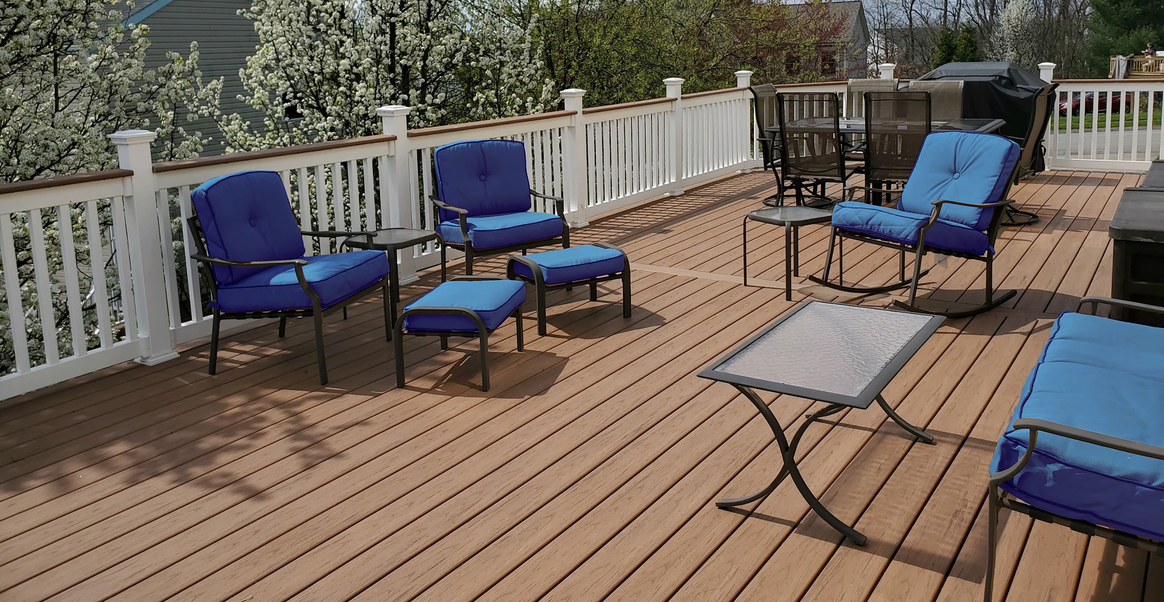
Limited Lifetime Warranty
Elevate your confidence in outdoor living with VEKAdeck's Limited Lifetime Warranty. We're committed to delivering a high-quality outdoor living solution that lasts.
Trust in the VEKAdeck warranty to provide you with unmatched protection and longevity.
VEKAdeck complies with CCRR-0317

Slide 16
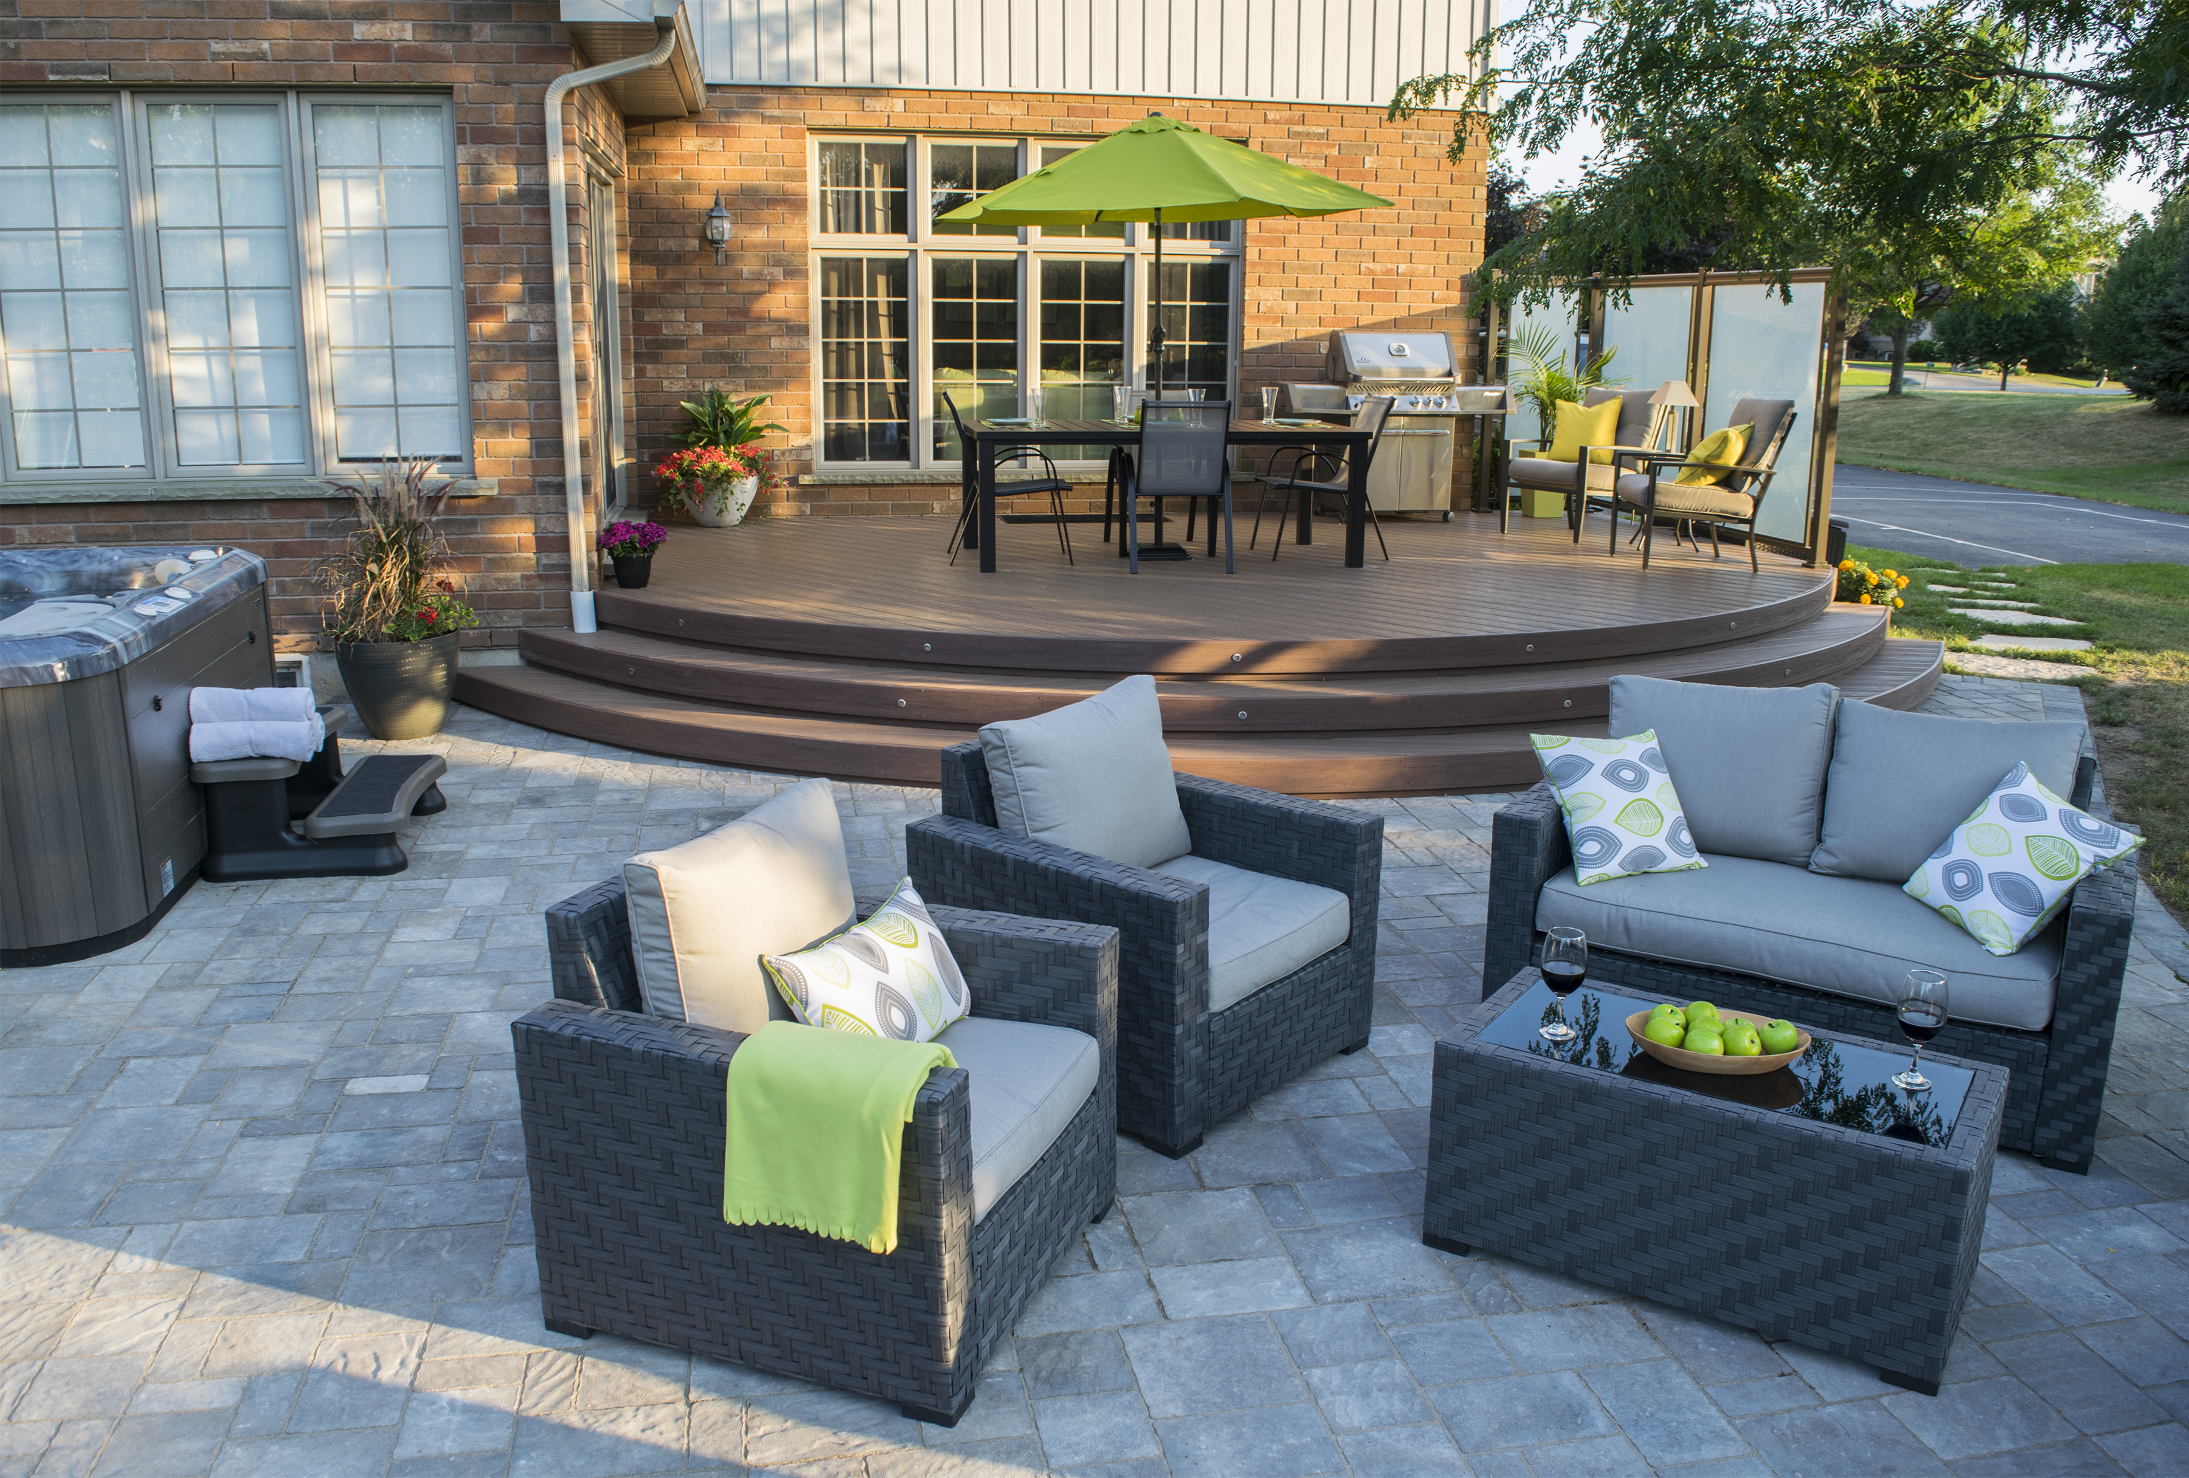
Advantages of VEKAdeck:
100% recyclable, superior mold resistance, and lighter weight.
Key Features of VEKAdeck PVC Decking:
Versatile colors, durability (30-50 years), mold resistance, and low maintenance.
PVC vs. Composite Decking:
PVC: 100% vinyl, longer lifespan,
and low maintenance
Benefits of PVC Decking:
Lightweight, resistant to water/mold/mildew/rot, customizable colors, recyclable, and superior lifespan/maintenance compared to wood.
DURABLE
STYLISH
LOW-MAINTENANCE

