Slide 1
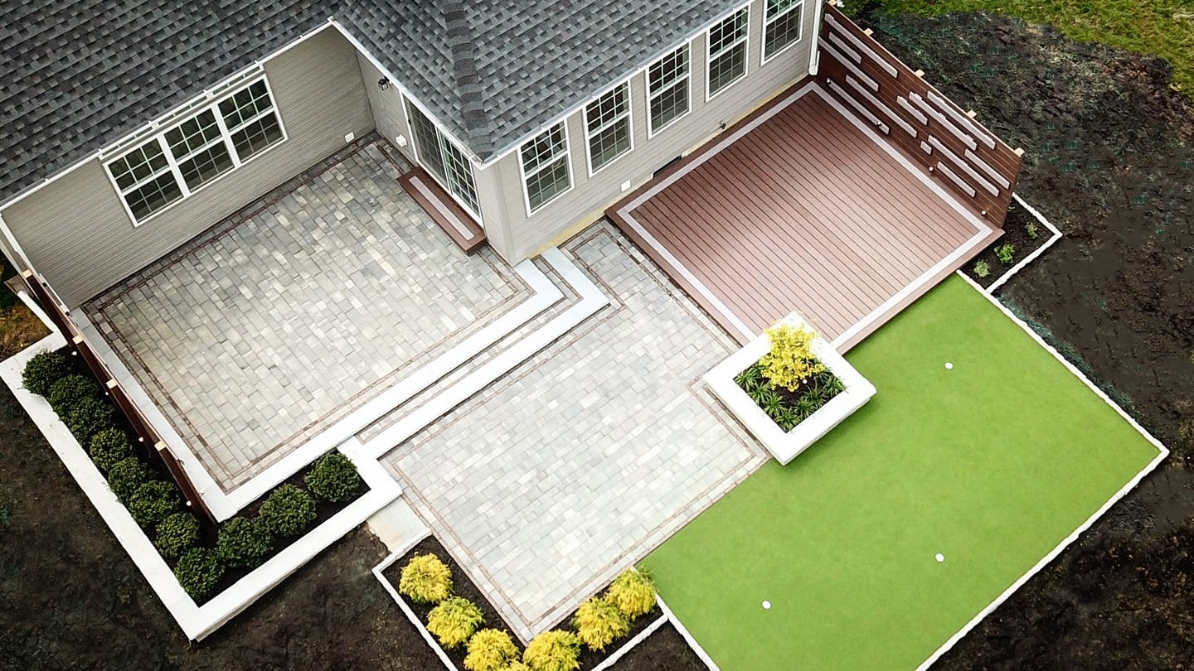


Revolutionizing Outdoor Living
to Create a More Sustainable Future

Slide 2
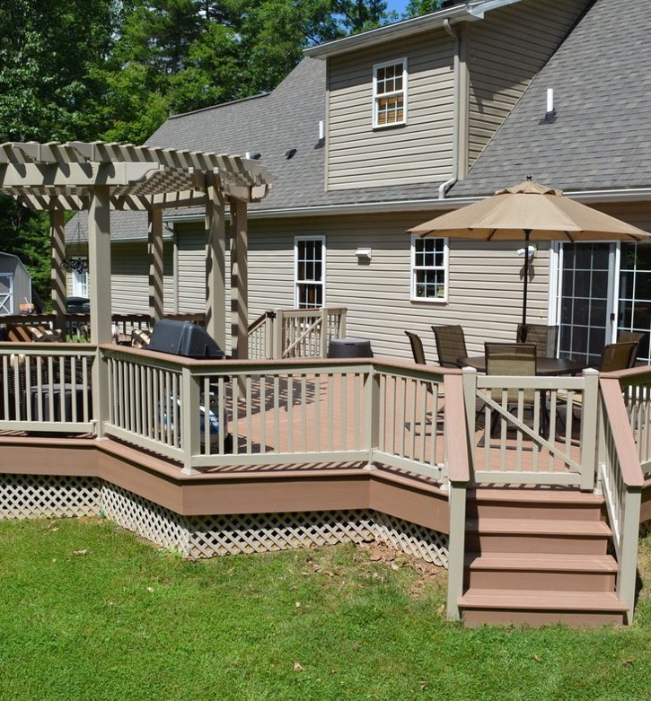

Built Locally,
Supported Globally
VEKA is the world's largest extruder of vinyl lineals for windows and doors, family-owned, prioritizing reliability, sustainability, and stability.
1969
50+
70+
Founded
in Germany
Years of
Experience
Countries for
Global presence
VEKA OLP has been in business operations since the year 2000, showcasing a substantial, longstanding presence in the industry.
.

Slide 3
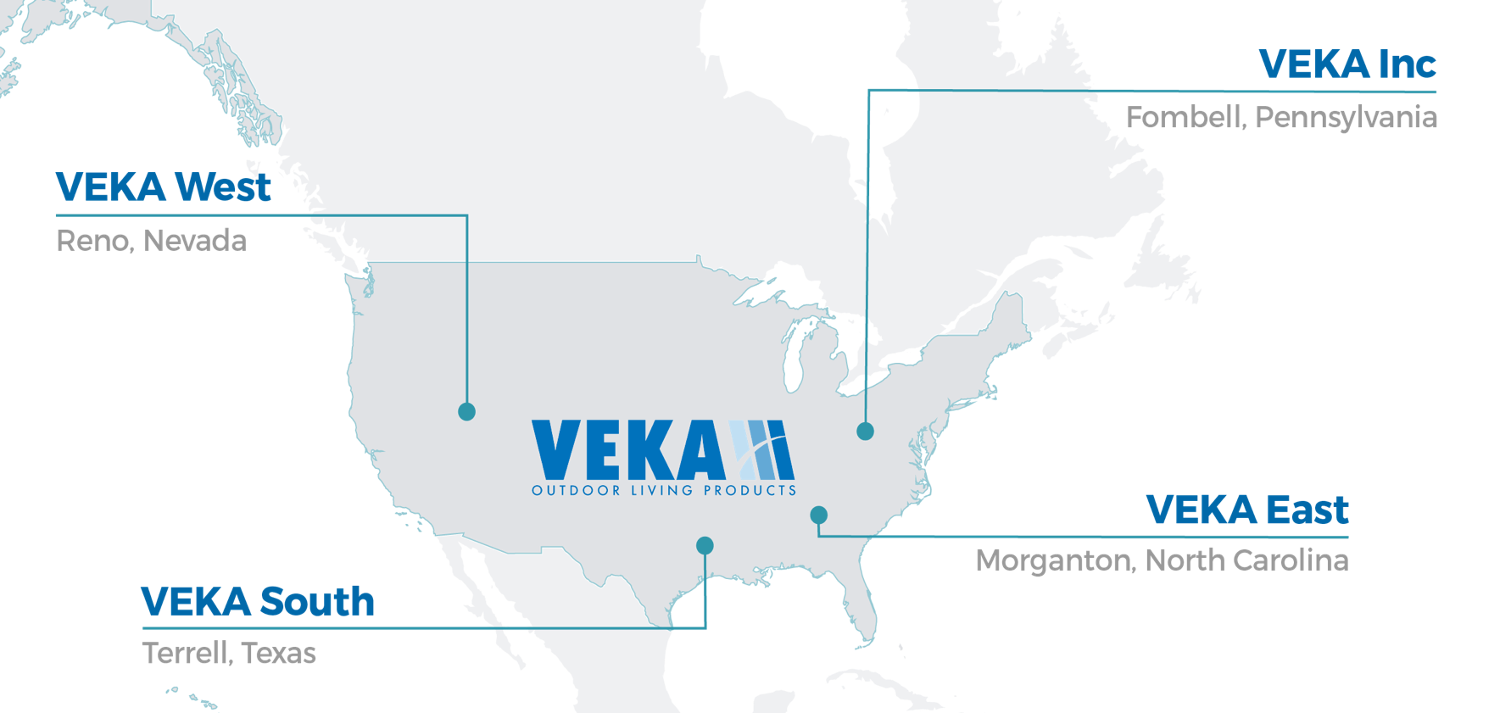
Solutions from Coast to Coast
corporate headquarters, central services
services OLP West
dedicated to Outdoor
Living Products (OLP)

Slide 4
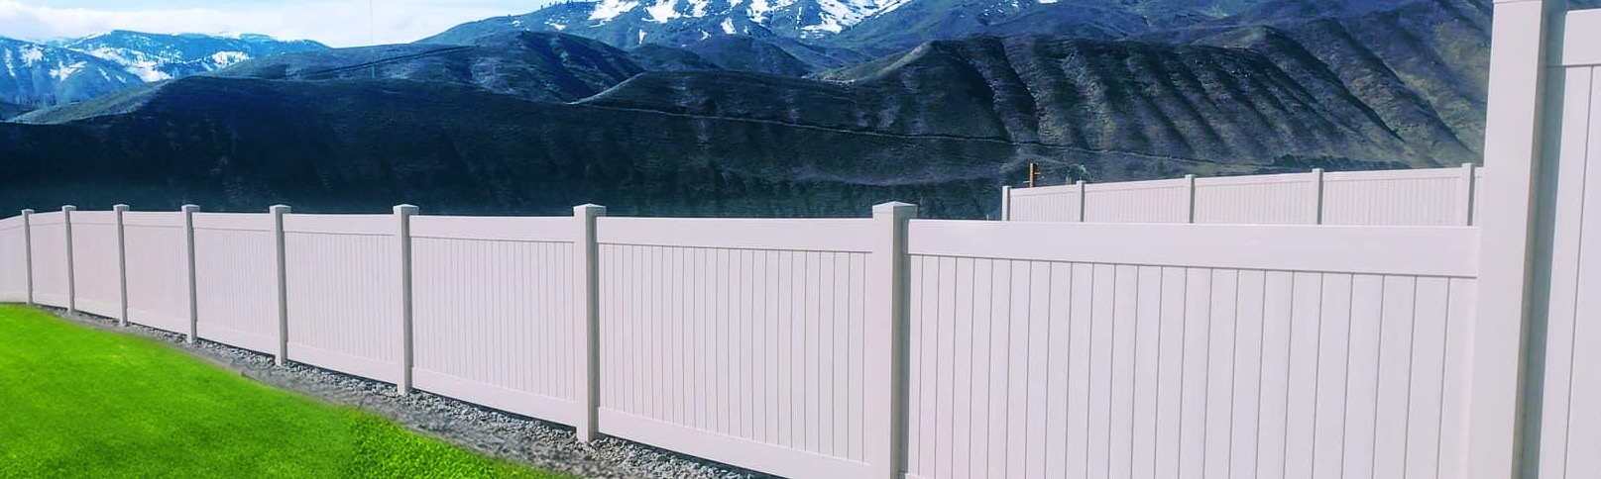
Privacy Semi-Privacy Picket & Pool Ranch Rail
Vinyl Fencing Products
Structural integrity and design flexibility
Our Full Line of Profiles and Fence Systems
Quality thick wall PVC profiles
Commercial and residential application
Great accent for property
Routed post with notched rails
Available in White, Almond, Khaki, Stone, and Signature Colors

Slide 5

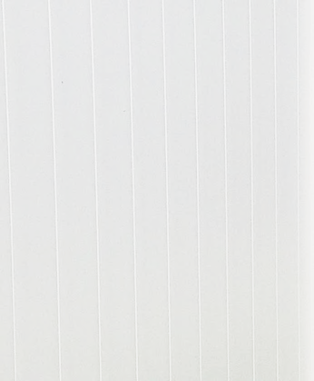

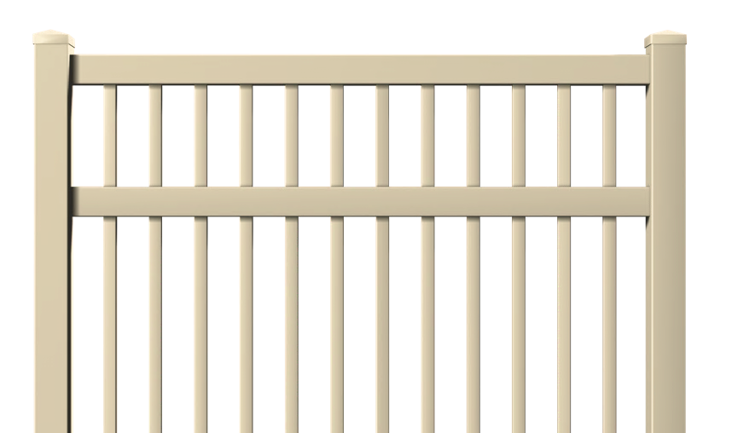
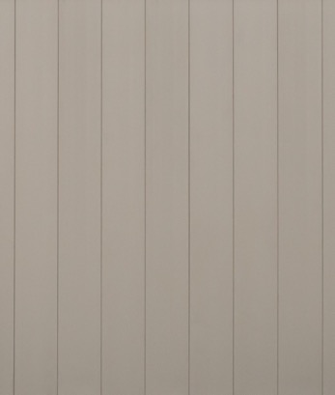
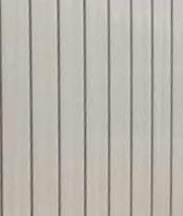
Protection, Privacy & Value
Vinyl Fence Colors
Our profiles outlast and outperform most other fence material. In addition to the standard testing like impact, weather, and wind, VEKA focuses on the American Society of Testing and Materials (ASTM) standards.
WHITE
ALMOND
KHAKI
STONE

Slide 6
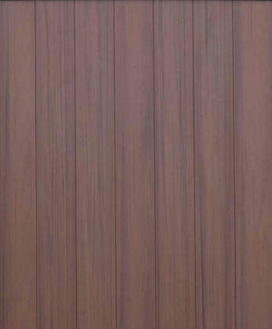
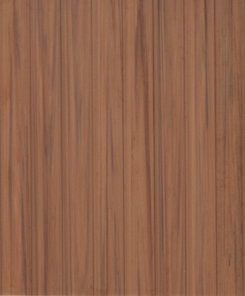
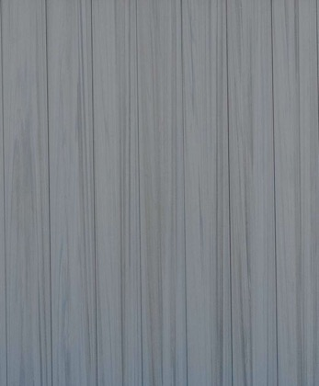
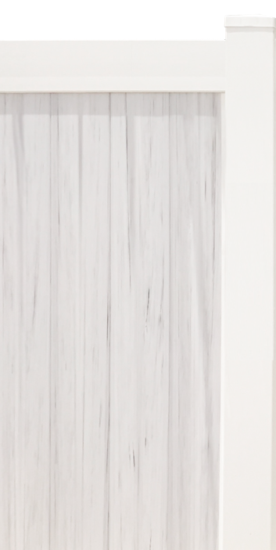
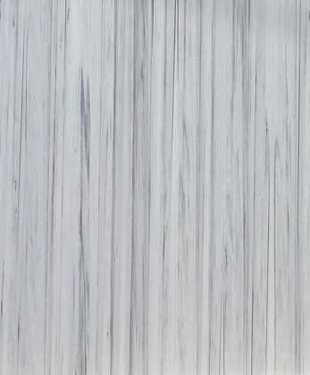
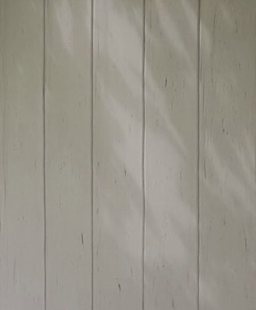
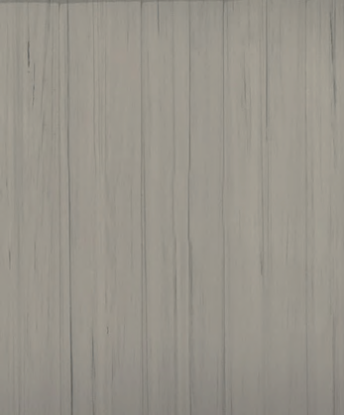
Fence
Signature
Colors
SIGNATURE
SIGNATURE
SIGNATURE
SIGNATURE
ESPRESSO
CAYENNE
HAZELNUT
STORM
Variegated
Colors
Pickets Only
WHITE
ALMOND
KHAKI

Slide 7

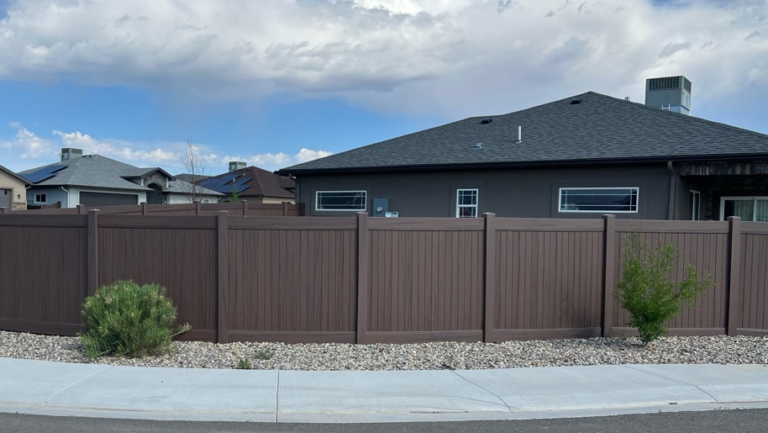
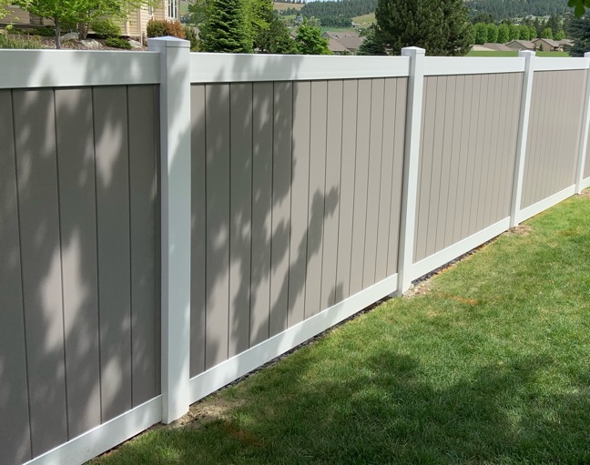
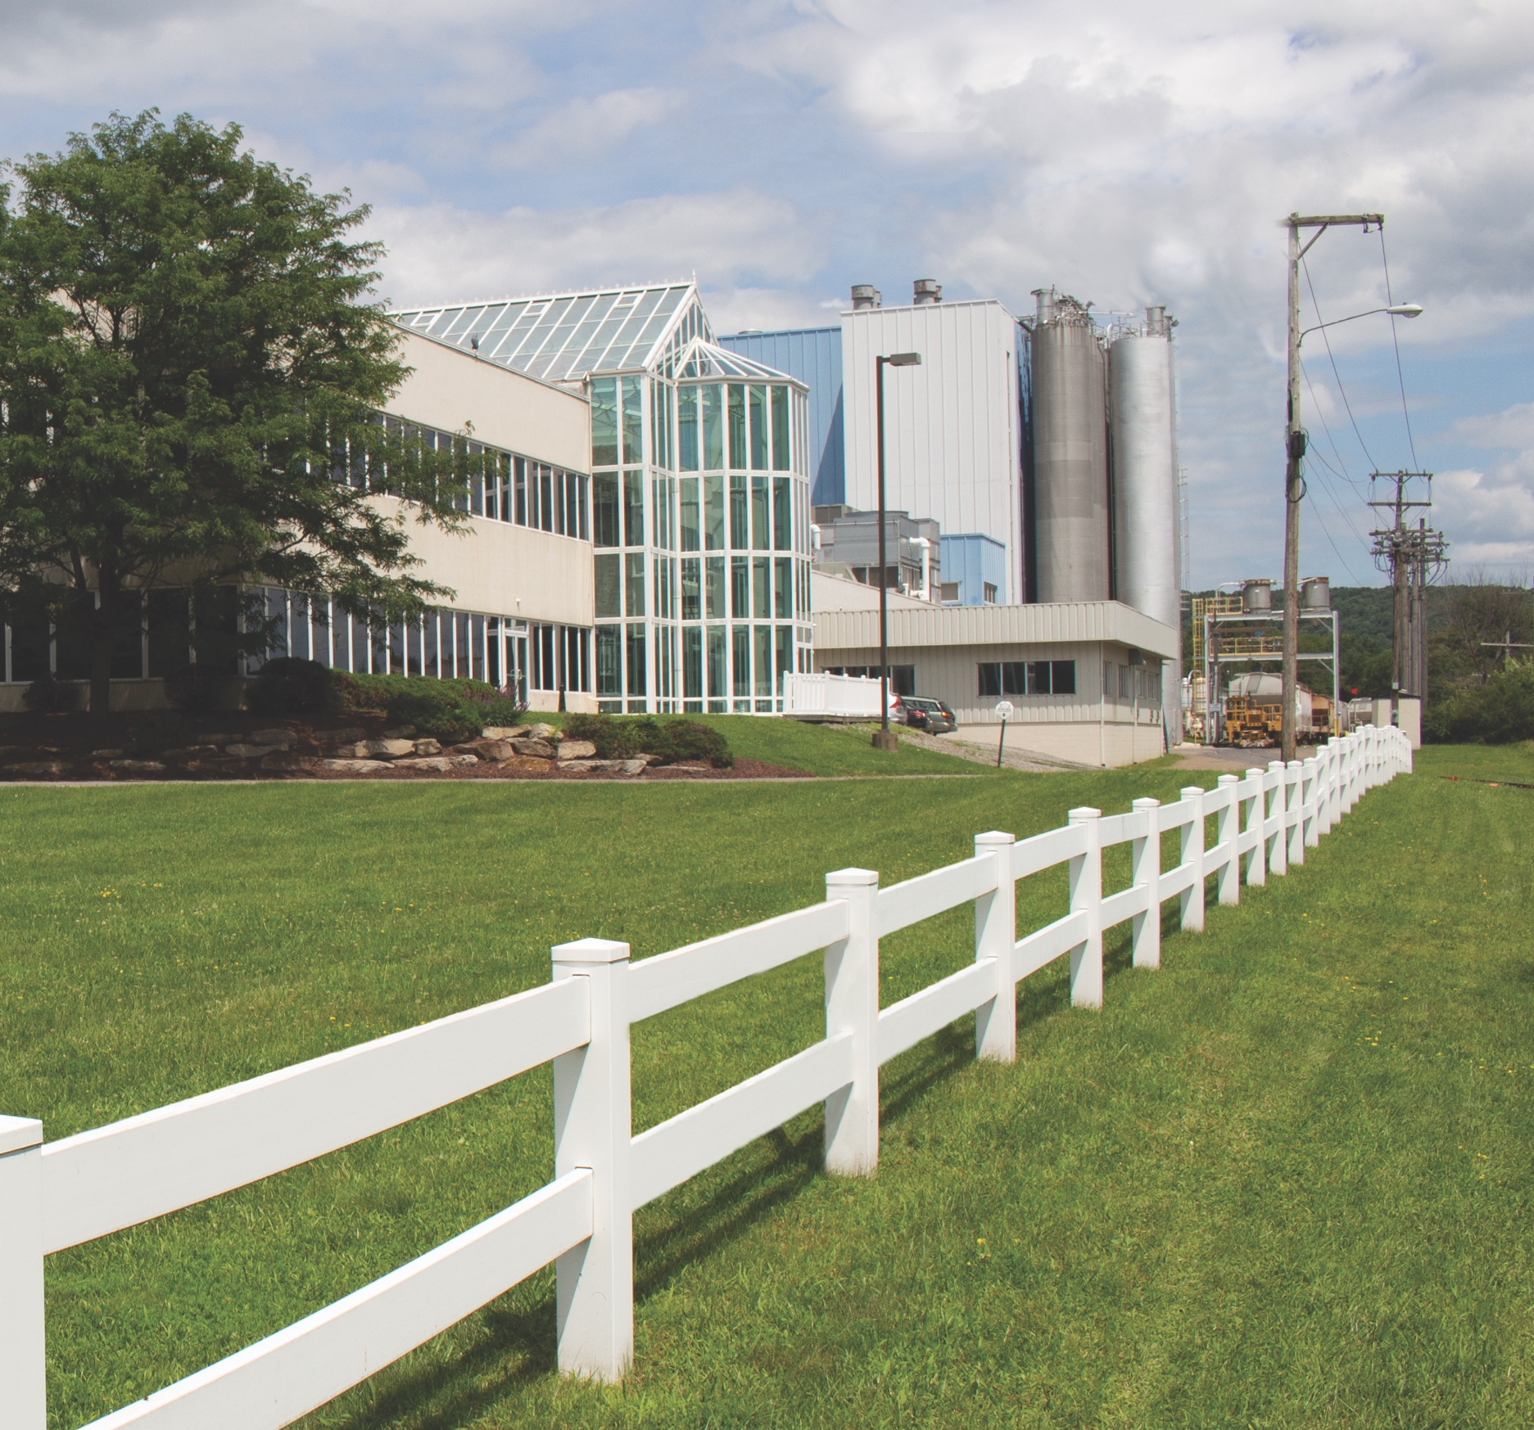
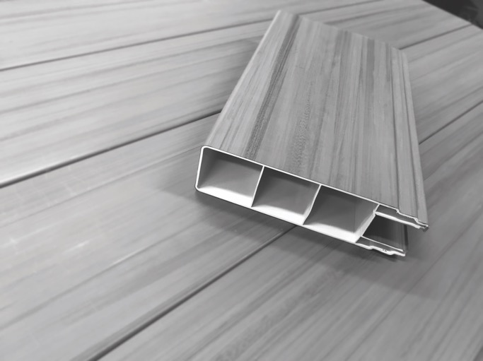
INSTALLATION GALLERY

Slide 8
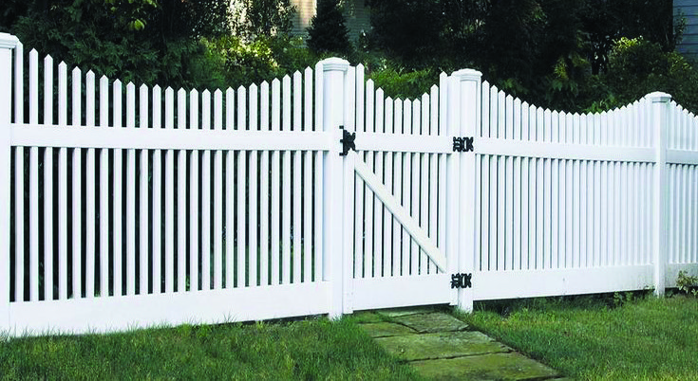
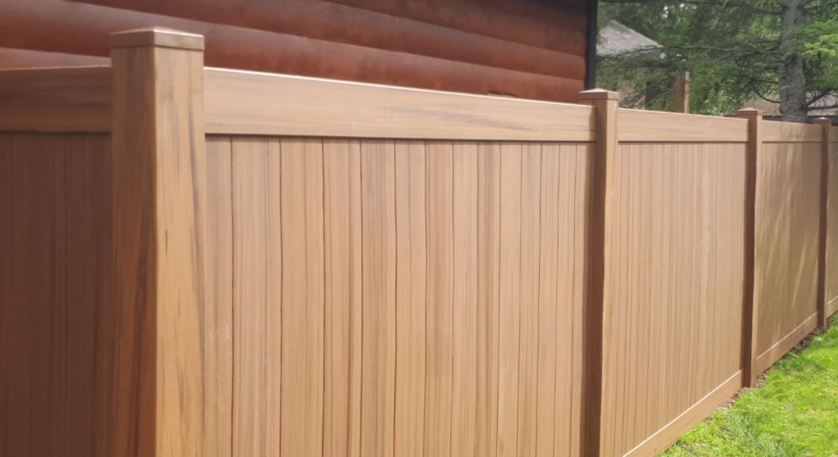
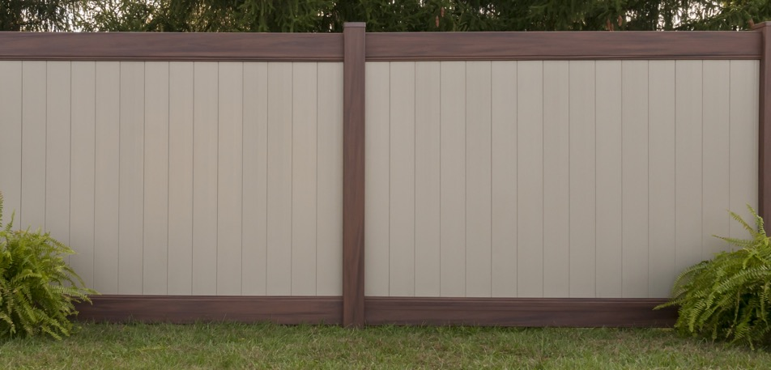
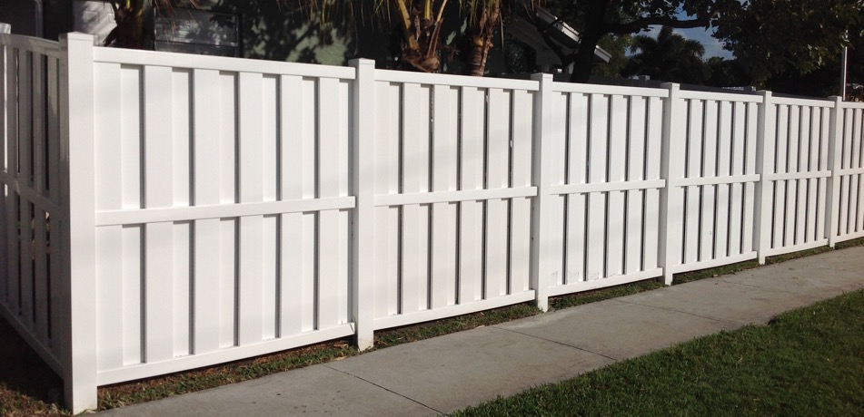

Slide 9
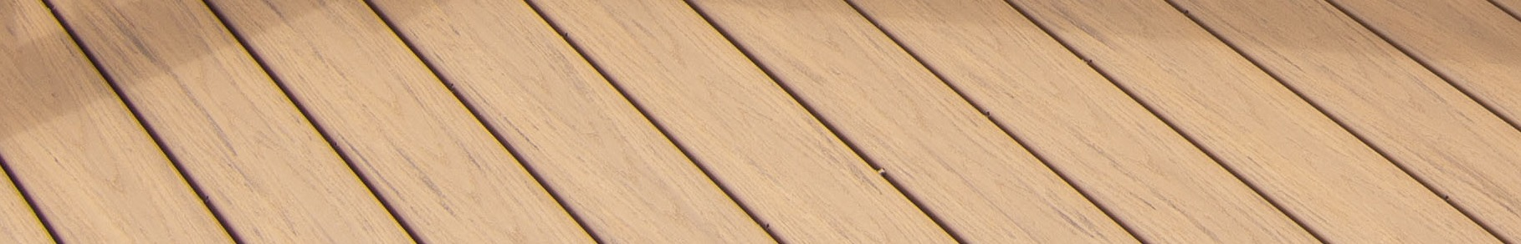

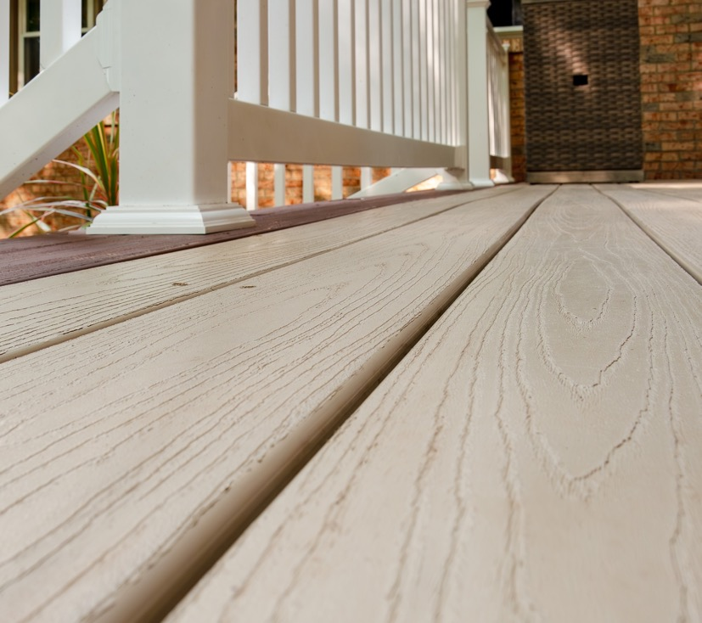
Transform
Outdoor Spaces
VEKAdeck Features
Cellular PVC deck board
Suitable for residential use
Environmentally-friendly alternative
to lumber and composite
Approved for ground contact, resistant to moisture and rot

Slide 10
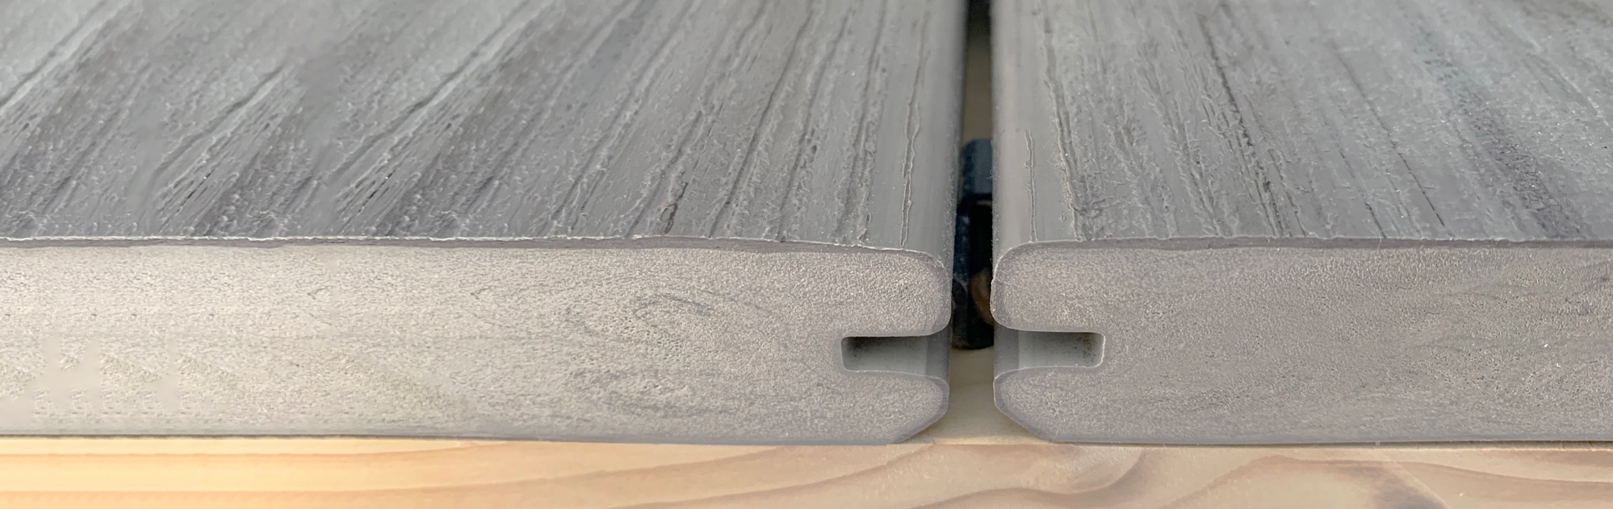
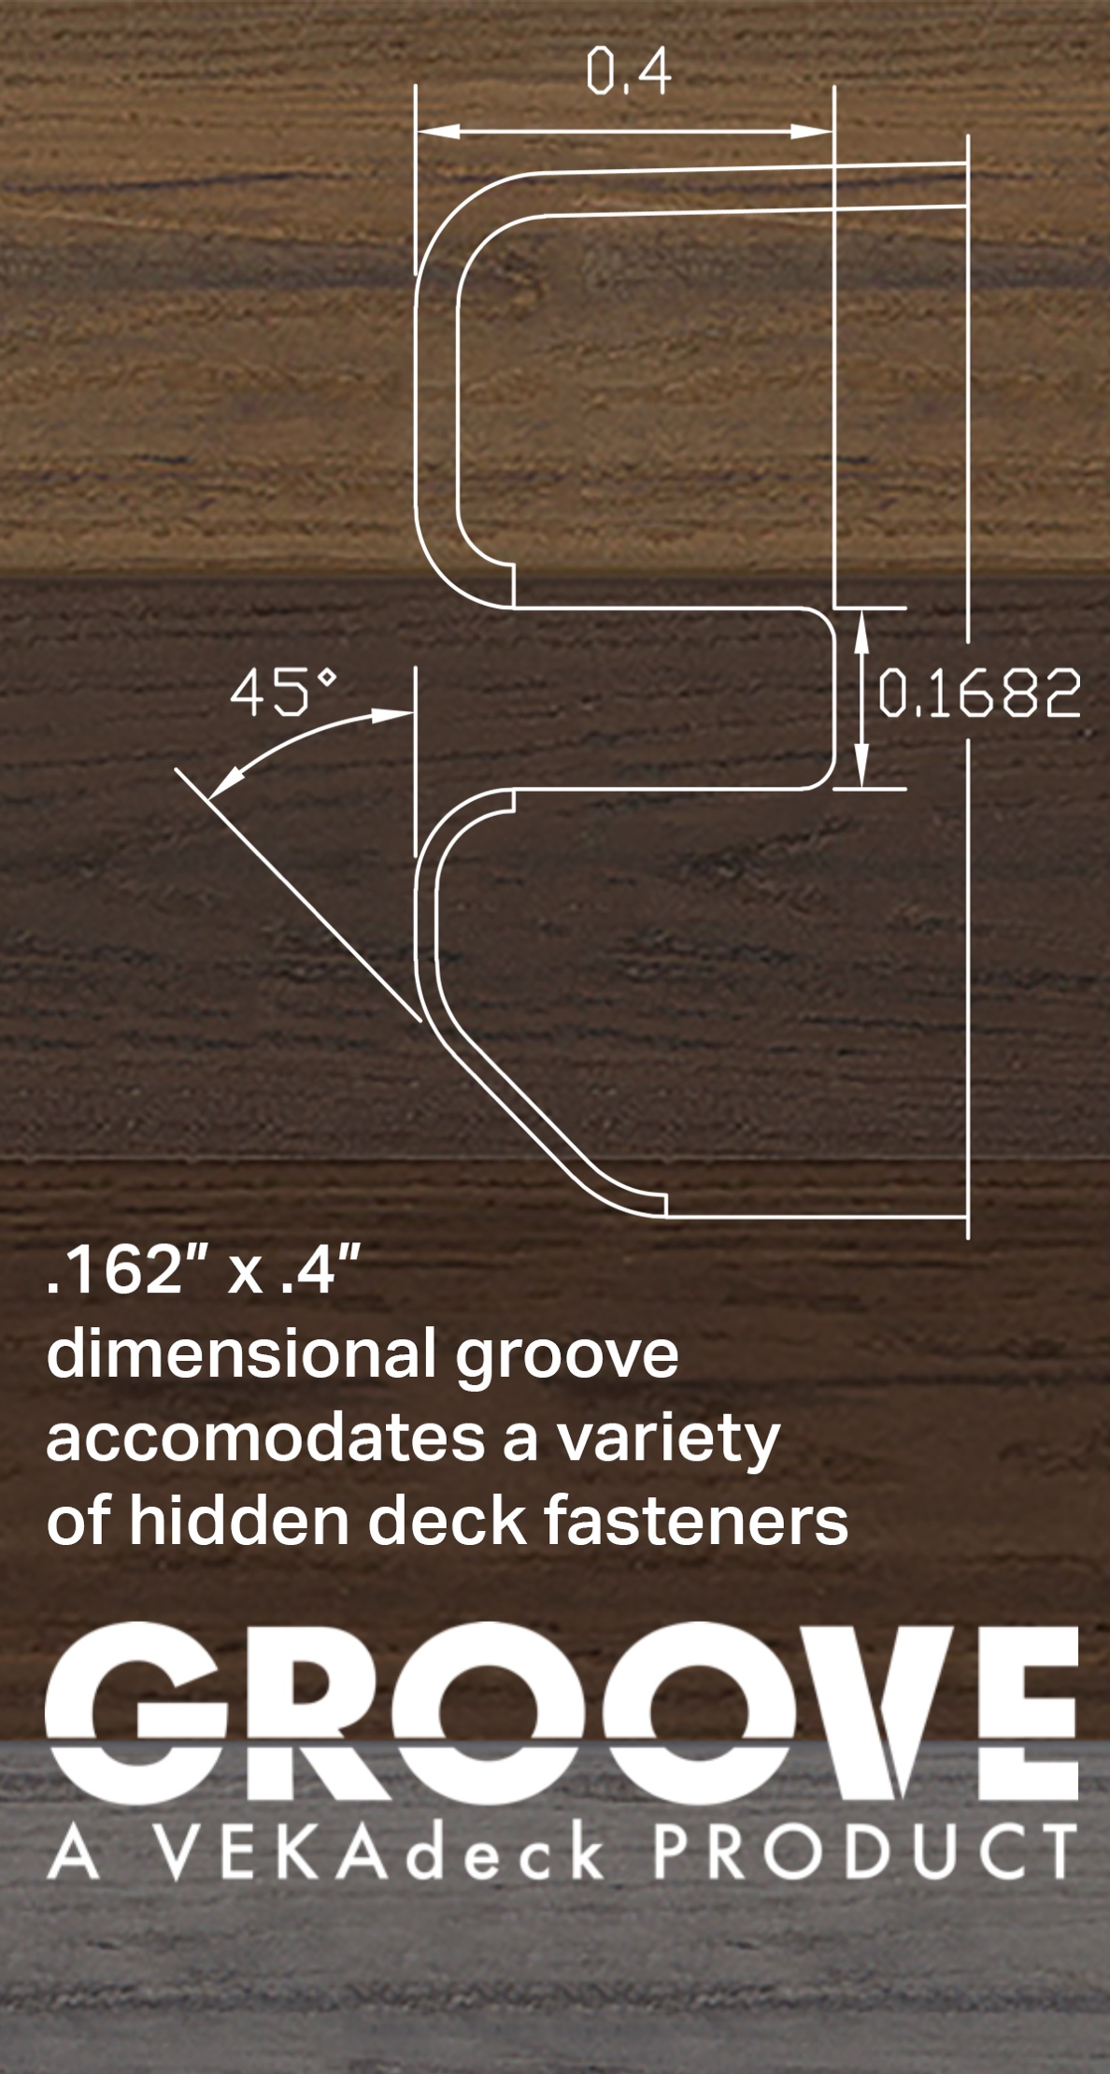

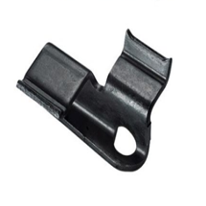
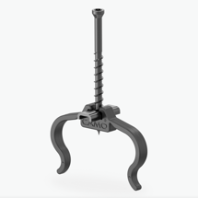
Proven quality with a modern, clean look
A beautiful deck surface without
visible screws
Compatible with most hidden deck fasteners designed for slotted PVC deck boards
The upper surface remains uncompromised by screws, plugs, or other systems that could affect its dimensional integrity

Slide 11

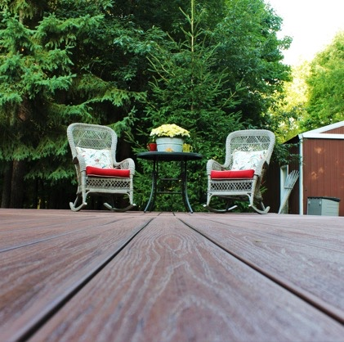
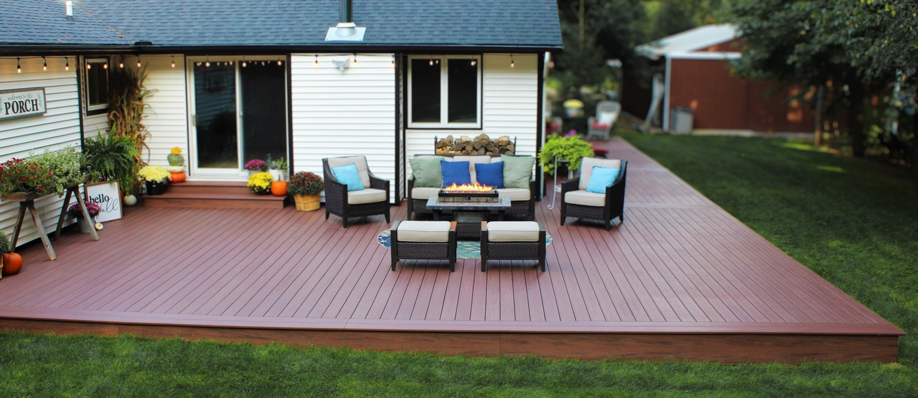

Slide 12
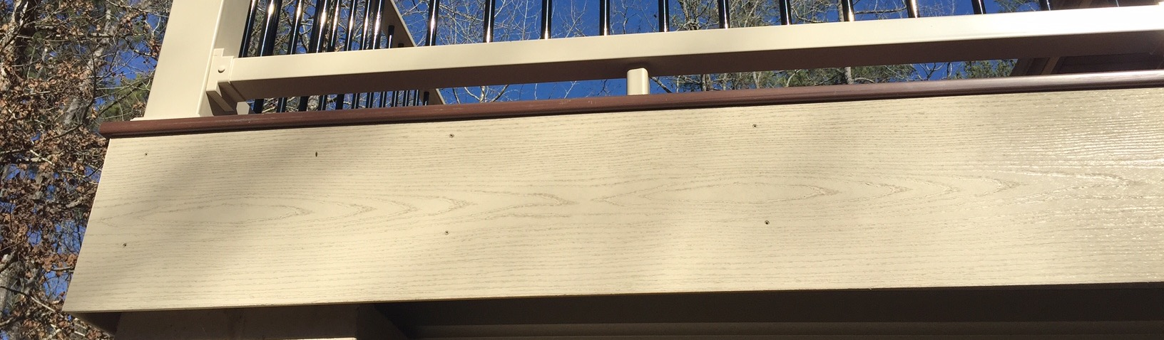
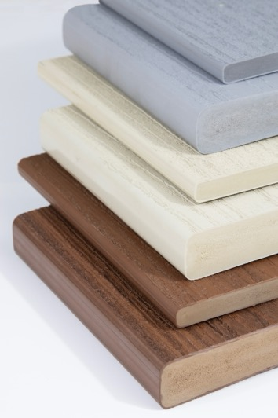
VEKAdeck
Fascia Board
A perfect combination of durability
Uses the same proven formula as VEKAdeck
Available in 12″ widths
7/16″ Thickness (.0437 in.) solid board
Installs just like VEKAdeck, can be nailed, screwed, or sawed.
Low maintenance, never needs painting or staining, cleans easily saving you time and money.
Limited Lifetime Warranty
Seamless blend in design
Coming soon! 8" Riser Board

Slide 13

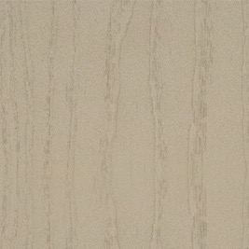
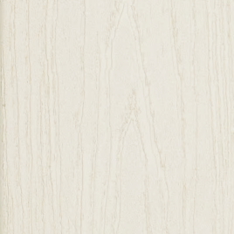
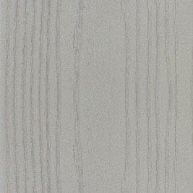
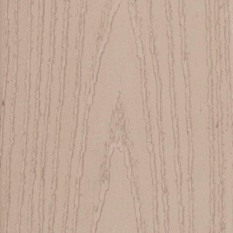
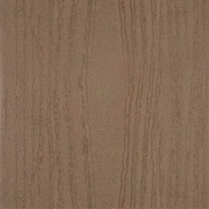
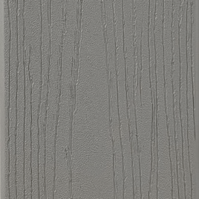
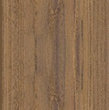
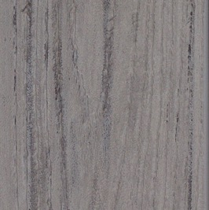
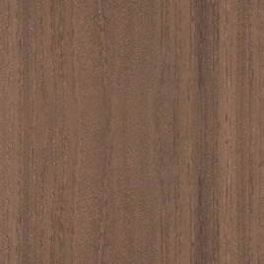
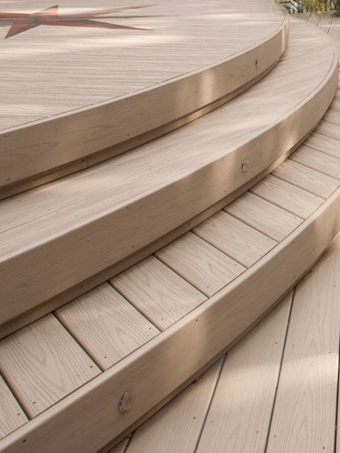
VEKAdeck & Fascia Color Options
VEKAdeck fascia colors perfectly
match VEKAdeck colors.
WHITE
KHAKI
ALMOND
GREY
MOCHA
WALNUT
SIGNATURE
SIGNATURE
SIGNATURE
SIGNATURE
PEWTER
HAZELNUT
ESPRESSO
STORM
CAYENNE
For custom looks, install VEKAdeck
fascia boards on curves and semicircles.

Slide 14
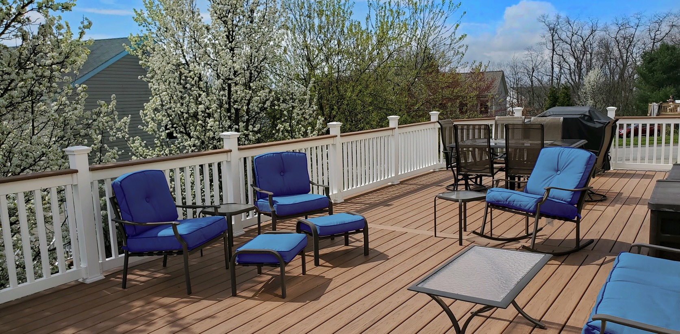

Limited Lifetime Warranty
Elevate your confidence in outdoor living with VEKAdeck's Limited Lifetime Warranty. We're committed to delivering a high-quality outdoor living solution that lasts.
Trust in the VEKAdeck warranty to provide you with unmatched protection and longevity.
VEKAdeck complies with CCRR-0317

Slide 15
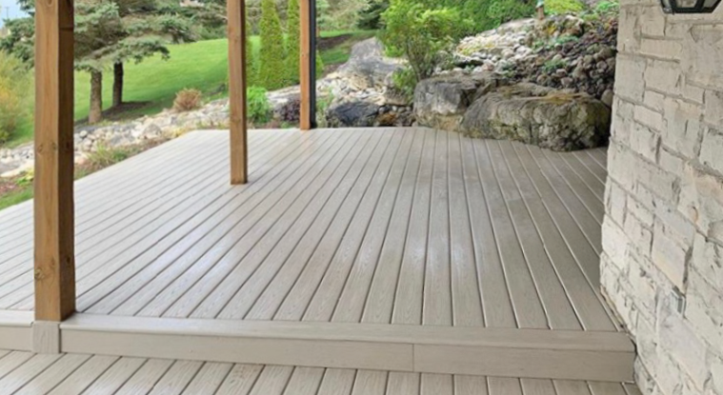

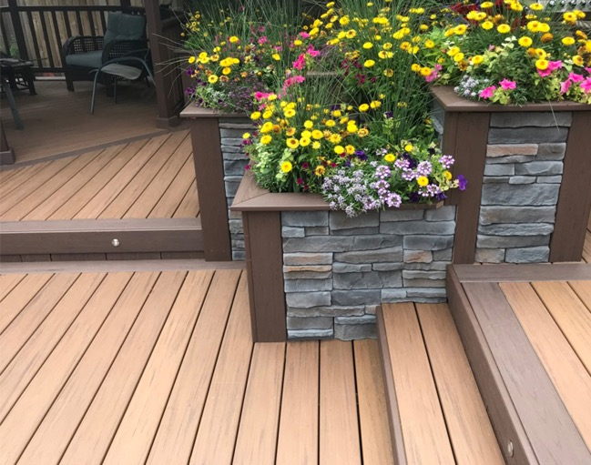
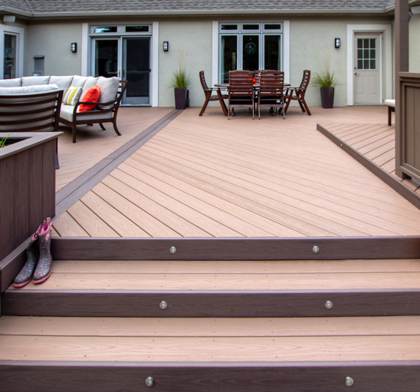
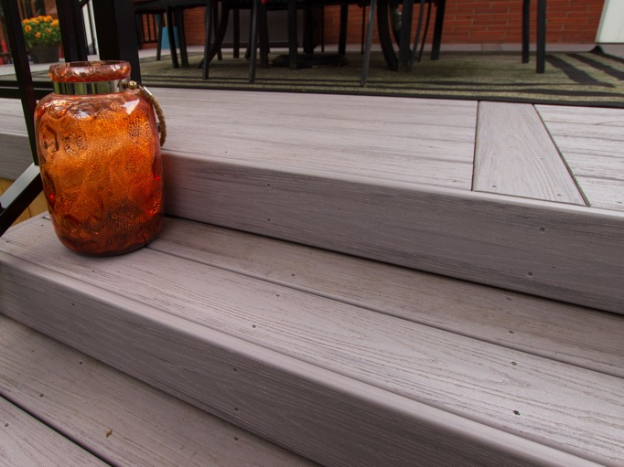
INSTALLATION GALLERY

Slide 16
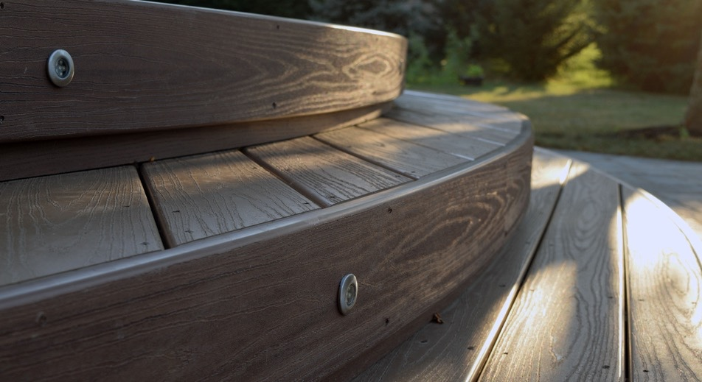
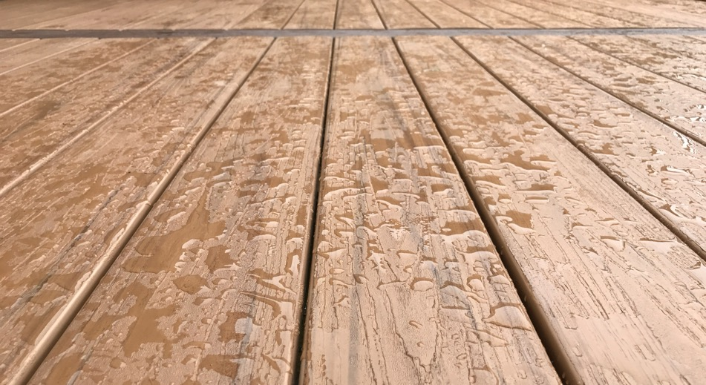



Slide 17


VEKArail
Engineered Handrail Solutions
Stylish & Economical

Slide 18













PRO V Series
PRO Z Series
Two-piece bracket connection on top & bottom rails
Aluminum reinforcement in top rail
Suitable for commercial & residential applications
Heavy-duty, nylon-backed bracket system
Compliant with load tests
CCRR-0138 compliant railing system
All-vinyl one-piece bracket system
Aluminum reinforcement in top rail
Suitable for residential applications
Passed and exceeded 1000 lb load test
CCRR-0138 compliant railing system
VEKArail products are available
in three vinyl colors:
WHITE
ALMOND
KHAKI
2 x 3.5 Rail
T-Rail
Decorative
Mini T-Rail
New! Signature Color Options for rail:
CCRR-0317
STORM
ESPRESSO
HAZELNUT

Slide 19





INSTALLATION GALLERY

Slide 20





Slide 21











Pinnacle Performance
Colors & Laminates
Distinctive solid colors with a durable pebble matte finish
Our laminate wood grain perfectly emulates the natural appearance of real wood, capturing its authentic color and richness for your fence or handrail profiles
Rich woodgrain appearance with exterior- grade performance
BRONZE
Crafted to withstand the elements, UV rays, and everyday wear, our premium laminate finish is backed by our 20-year warranty.
COCOA
ROJO OAK
GOLDEN OAK
WALNUT
MAHOGANY
BLACK ONYX
WHITE ASH
GOLDEN HONEY
WEATHERED
CEDAR

Slide 22




Environmental
Responsibility
Since the launch of our Outdoor Living Products Division, VEKA has focused
on sustainability initiatives by using in-house , high-quality window and door recycled material, mixed color, pre-consumer, reclaimed PVC for agricultural post & rail, extruded packaging containers, and liners.
DualEdge Eco Layer profiles are VEKA’s first introduction of this reclaimed material into the marketplace.
By ensuring that the highest quality ingredients are blended into the formulation, VEKA can guarantee that DualEdge goes beyond industry standards.
As a result of proven performance, DualEdge® comes with a limited lifetime warranty.

Slide 23

















Our Library of Profiles
F090U 5A
F0915 1T
F0915 5T
F0930 1T
F0930 5T
F0960 2T
F0960 3T
F0960 5T
F0960 6T
F0960 9T
F0970 3T
F09112 3T
F09112 5T
F09112 6T
F09112 9T
F09113 3T
F1010 1T
F1039 1A

Slide 24


















Our Library of Profiles, cont.
F1313 1T
F1414 1T
F1438 1A
F1458 1A
F1515 4T
F1515 5T
F1555 2R
F1555 4R
F1555P 4R
F1580 4R
F1818 1T
F1835 1R
F1835D 4R
F1855D 4R
F1855F 4R
F2035 1R
F2035 5R
F2060 1R

Slide 25


















Our Library of Profiles, cont.
F2060 5R
F2070 4R
F2070D 4R
F2080 1R
F2080 2R
F2126 1R
F2335 1R
F30MT 1R
F300T 1R
F350T 2R
F3030 1R
F4040 1P
F4040 5P
F4040 9P
F5050 1P
F5050 5P
F5050 8P
F6060 5P

Slide 26


Thank You
VEKAOLP.com
VEKAOLP.com
John Smith
jsmith@veka.com
123.456.789

